Slide 1

Welcome!
Notes:
Susan

Slide 2

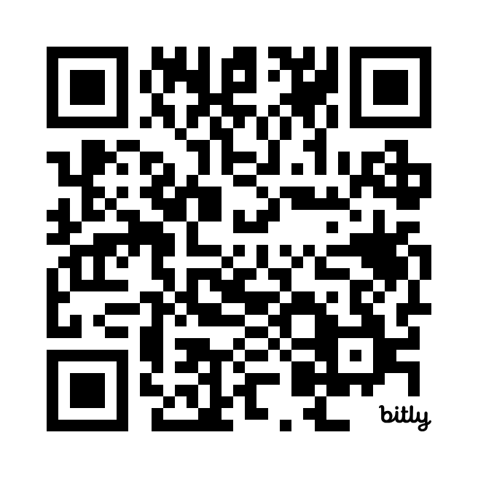
Program Accessibility
Real-Time Captioning provided by Efficiency Reporting
ASL Interpretation provided by 5 Star Interpreting
Notes:
Susan

Slide 3
Cultural Access Collaborative
We believe arts and culture are for everyone. Our mission is to empower Illinois’ cultural spaces to become more accessible to visitors with disabilities.
4 Pillars:
Professional Development
Accessible Equipment Loans
Access Calendar
Network
Notes:
Susan

Slide 4
Sighted Guiding and Accessibility Training
By: Mandi Hetzel, COMS, CVRT

Slide 5
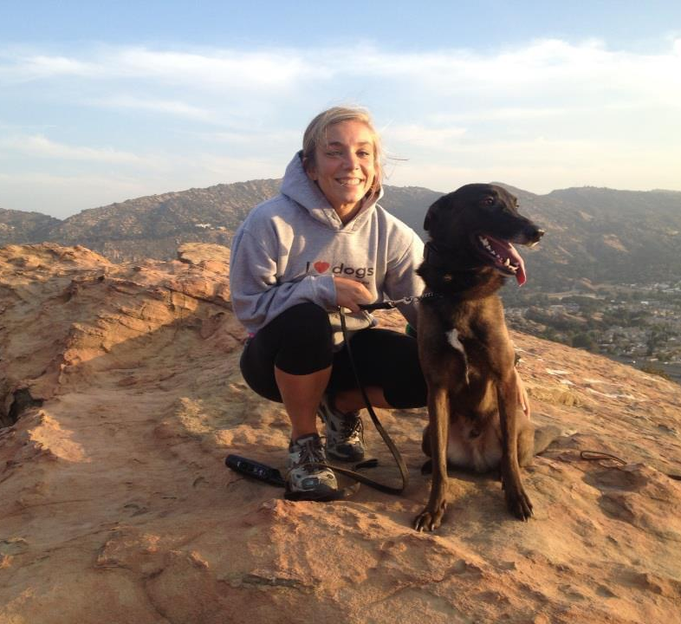
Introduction
Certified Orientation and Mobility Specialist and Vision Rehabilitation Therapist at Second Sense
Second Sense – non-profit agency in Chicago
Orientation and Mobility Training
Daily Living Skills
Assistive Technology Training
Orientation and Mobility: teaches the use of mobility aids such as white cane or guide dog to travel more independently; focuses on non-visual navigation techniques

Slide 6
What is Sighted Guide?
Sighted guide is one of 3 (currently) types of primary mobility aids
White cane and guide dog are the other two
This allows those who are blind or visually impaired to navigate independently
Independence = capable of thinking of acting for oneself
If an individual asks for or believes sighted guide to be the technique that will best serve them in that situation or moment they are still independent
Sighted guide should act to give the learner agency
Asking for assistance is encouraged throughout Orientation and Mobility training

Slide 7

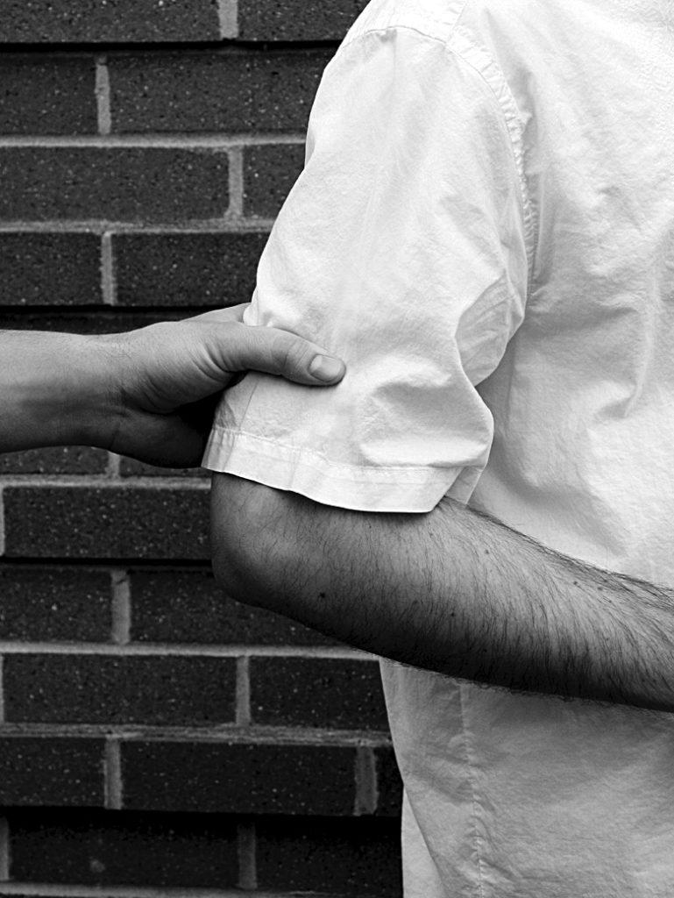
Basic Sighted Guide Technique
Making contact
Guide verbally offers arm and makes contact with the back of learner’s hand with the back of their hand
Following position
Learner trails up hand to position hand above guide’s elbow
Hint for guide: bend elbow to allow learner to locate easier and straighten again once grip is established
Note: position can be adjusted for different heights
Learner grasps guides arm just above elbow with thumb positioned on the lateral side of arm and fingers on the medial side
Learner’s arm is positioned parallel and close to side of body and form a 90 degree angle
The learner should remain ½ step behind the guide as they walk together
Notes:
If a guide needs to break contact with learner it is their responsibility to make sure the learner is oriented before leaving (i.e., if at a bus stop show learner to pole or bench rather than leaving them in open space)
If guide and learner are familiar with each other, dynamic and technique may change

Slide 8
Communication
Learners are instructed to be “active” during the human guide process rather than “passive”
Encouraged to keep track of location, number of turns, auditory and/or visual landmarks, changes in surface texture or slope
Guides should be giving pertinent information rather than over-explaining all the surroundings of the learner
Turns
Narrow passageways
Doorways
Stairs
Elevation changes
Street entry (sometimes)
Learner may ask for more information which is fine
Learners are encouraged to communicate about speed of walking
I.e., asking guides to speed up or slow down
Guide may communication to learner if they are gripping arm too tightly
THE MAIN GOAL OF SIGHTED GUIDE IS TO NEVER LOSE CONTACT WITH THE LEARNER AND VICE VERSA

Slide 9
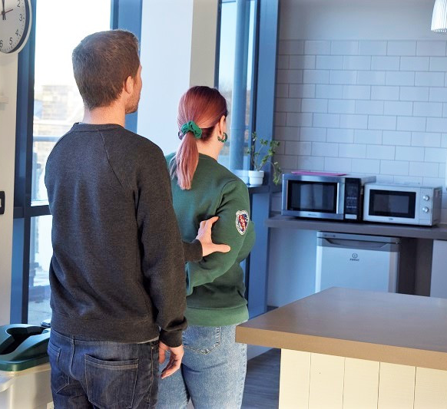
Narrow Passageway
The guide should move their arm behind and toward the small of their back
The learner extends their arm and moves directly behind the guide, sliding their hand down to the guide’s wrist to create more space
The guide returns their arm to normal and announces when the space is no longer narrow for learner to resume original position

Slide 10
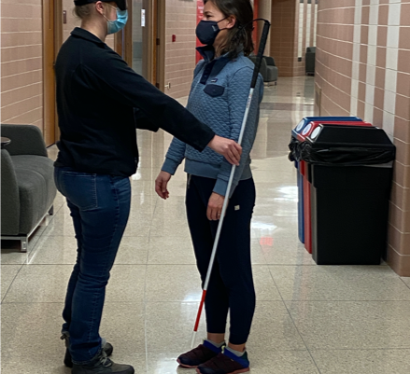
Changing/Reversing Directions
The guide indicates the need to reverse directions
Guide and learner turn 90 degrees to face towards each other
The guide initiates contact with free hand and then the learner grasps the guide’s free arm and releases the other arm
Guide and learner then complete the rest of the turn until they are facing the opposite direction
Alternative to turning in a circle, especially in a tight space

Slide 11
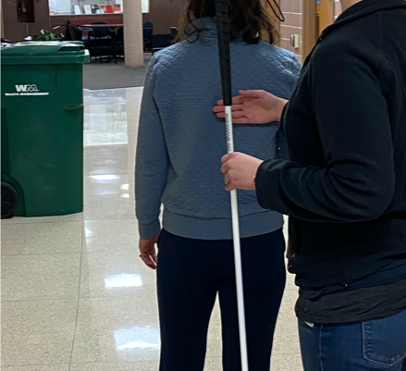
Switching sides
Reasons for switching sides:
Learner preference
Doorways
Handrails
Upcoming obstacles
Can be done in motion or stationary depending on learner’s comfort/skill
Guide or learner should indicate a need/desire to switch sides
The learner grasps the guides arm with their free hand just above existing grip
Learner releases original grip and slides hand across upper back of guide to find elbow on opposite side
Once contact is made with opposite arm and learner gets into correct position, the grasp on the original arm can be released and that hand will replace the hand on current arm

Slide 12
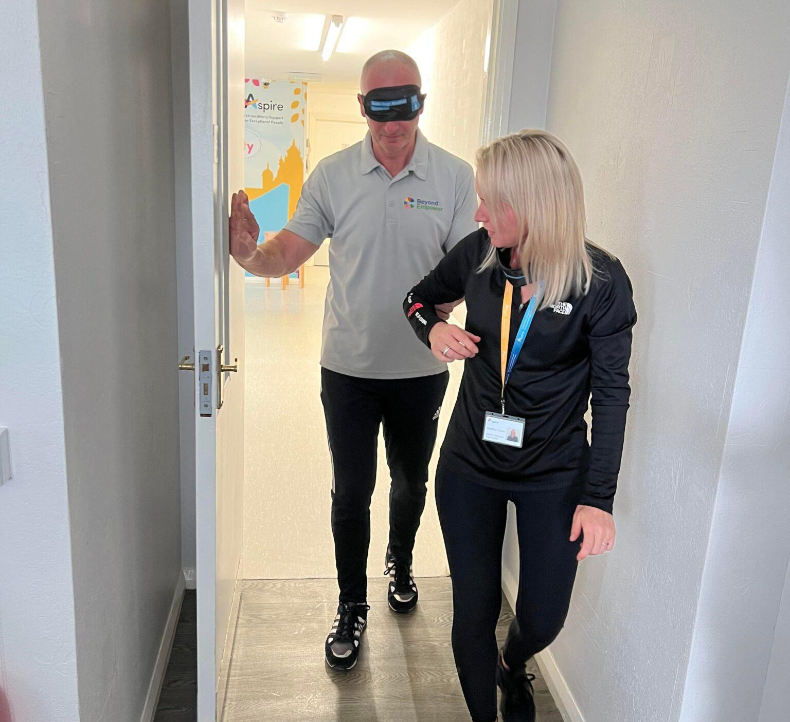
Doorways
To start the guide should announce that they team is approaching a door
The learner should be on the same side of the guide as the hinges of the door so they may need to transfer sides if they are on the wrong side
Note: learner should ask the guide what side the hinges are on before navigating the door
Once the learner is on the correct side the learner should reach out to locate the door and either continue pushing it up or pulling it open
Note: guide should tell learner if door is a push or pull before learner receives the door
The learner then negotiates the door for themselves rather than having the guide hold it for them the entire time
Once through the door learner can choose to switch sides again or remain on the same side
Revolving doors
Guide walks learner into receptacle and learner places their hand on push bar
Guide walks behind learner in separate receptacle and reconnects once outside
Quick notes:
Narrow passageway technique may be used for doorways
General rule: doors in homes and individual rooms open inwards to rooms while external building doors open to the outside

Slide 13
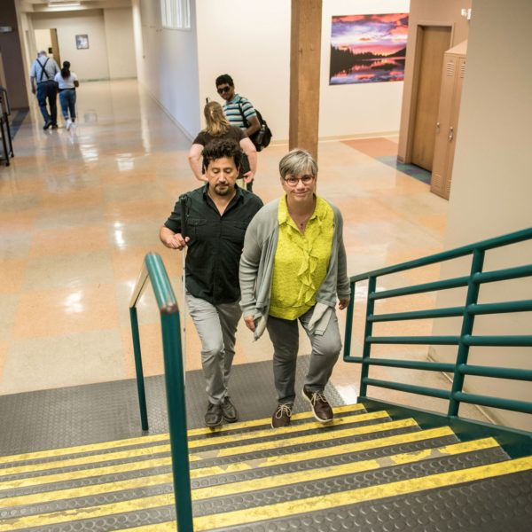
Ascending and Descending Stairs
Guide approaches the edge of the stairs and announces to learner whether stairs are ascending or descending
Guide should pause to allow learner to align themselves and find the handrail if applicable
The guide should take one step to be ahead of the learner and then begin ascending or descending when the learner is ready
When the guide’s first foot approaches the landing with one step to go, the guide should say “last step” so that the learner knows
Note: learner may have to switch sides before ascending or descending for the handrail

Slide 14
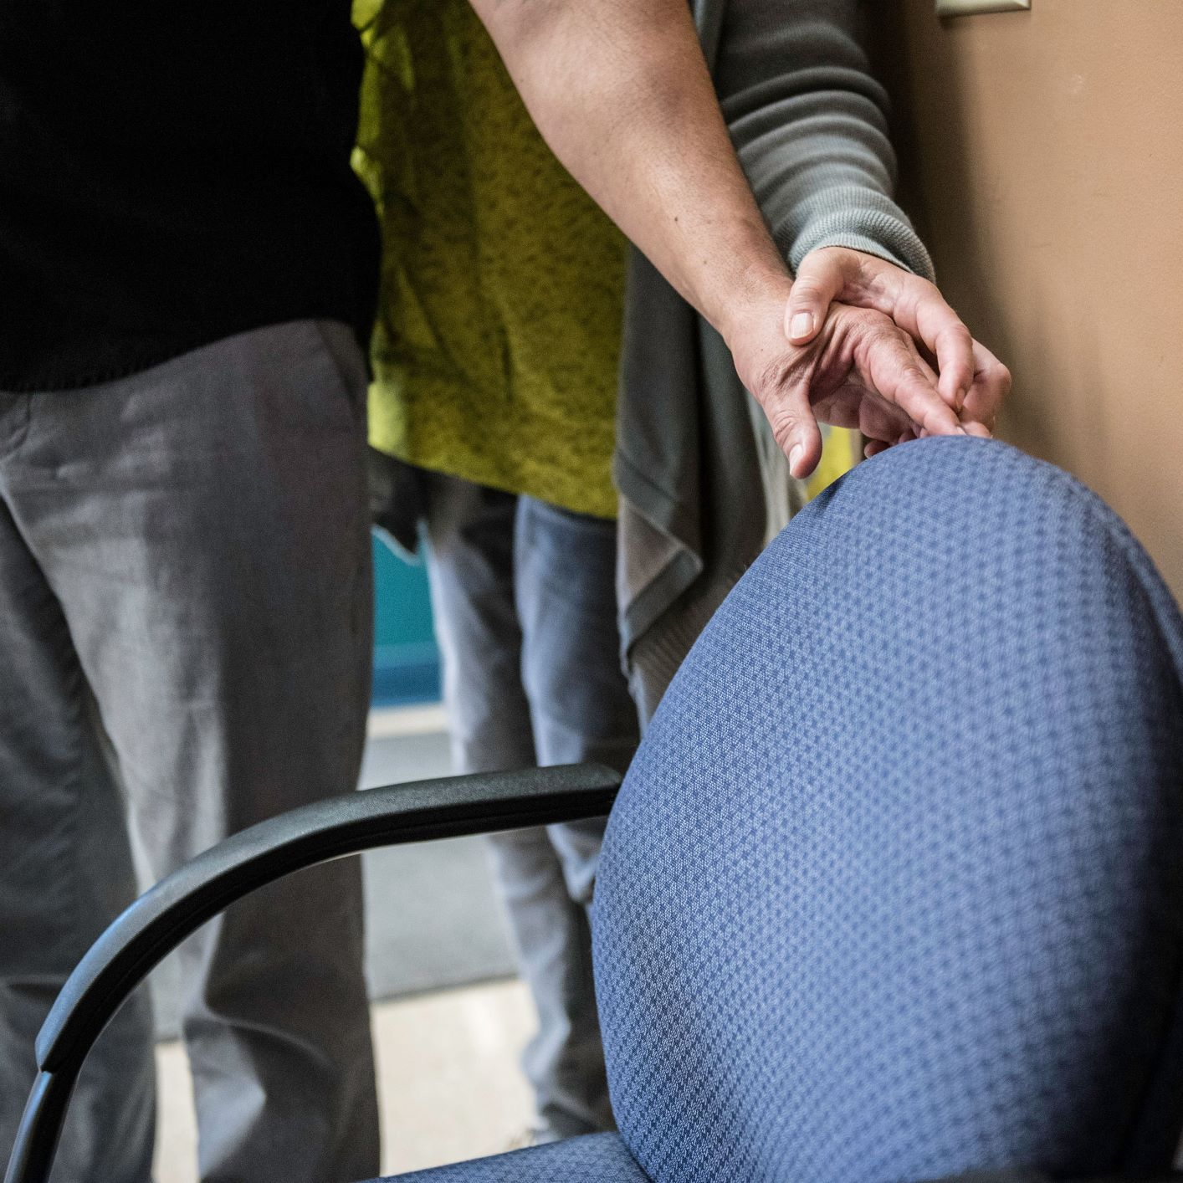
Seating Procedures
The guide team approaches a seat
The guide can choose to describe the type of seat (bench, chair, stool, etc)
The guide can then place their hand on the back of the chair or the seat of the chair and learner releases their grip on the elbow and follows the guides arm all the way down to where they have made contact with the chair
Learner repositions themselves to face the seat and uses upper-protective technique to be in a position to “clear” the seat
Learner then bends to “clear” the seat (making sure nothing is in it)
Learner then places the back of their legs against the front of the seat and sits down
Note: guide should always tell the learner if their seat has wheels, no back, or no arm rests to prevent falls
The same technique used for initially locating chairs can be modified for locating car door handles

Slide 15
Auditorium Seating
The guide pauses at the appropriate row and indicates to the learner to position themselves alongside the guide in preparation for entering the row in a sideways manner
The guide starts into the row, sidestepping as needed if there is limited clearance for walking
The learner may use the back of their free hand to trail the back of the seats of the row in front
The guide stops at appropriate seats providing a verbal cue that they have arrived
The learner uses the back of their legs to contact the seat and with continuous movement clears or pushes the seat down in order to sit

Slide 16
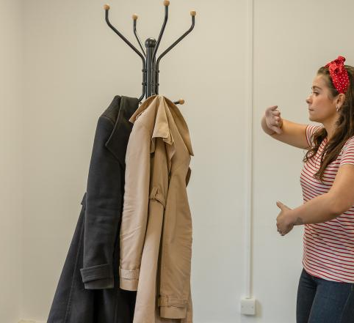
Protective techniques
Upper-body protective technique
Arm is positioned in front of the learner, parallel to the floor and at shoulder level
Forearm is bent at the elbow
The palm is facing forward with fingers and thumb held together and relaxed, and fingertips extended approximately one inch beyond the opposite shoulder
Note: guide can instruct learner to use upper-body protective technique in areas where there are overhead obstacles (low hanging plants, bushes, etc)
Lower-body protective technique
The learner’s upper arm, forearm, wrist, and fingers are held in a straight yet relaxed manner in front of the body, with the hand pointing downward
The palm is facing the body at midline, with the fingers remaining close together, relaxed, and pointing downward
The hand is extended approximately 8-12 inches away from the body
Note: provides protecting from waist level obstacles

Slide 17
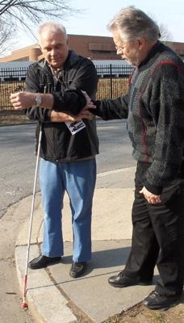
Accepting or Refusing Assistance: Hines Break
A learner may refuse assistance at any point at their own discretion
High probability of refusal if guide attempts to grab learner’s arm or hand
To refuse help the learner may practice the Hines Break method:
The learner should relax the arm that is grasped and raise it towards their opposite shoulder keeping their feet stationary
With their free hand the learner should grasp the “guide’s” wrist while stating intentions to accept and correct or refuse assistance
The learner then pulls the person’s wrist forward until the other person loses contact
Learner can also accept assistance and correct guide’s approach

Slide 18
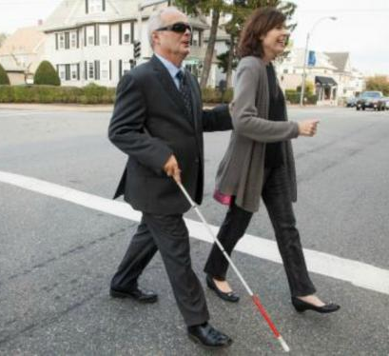
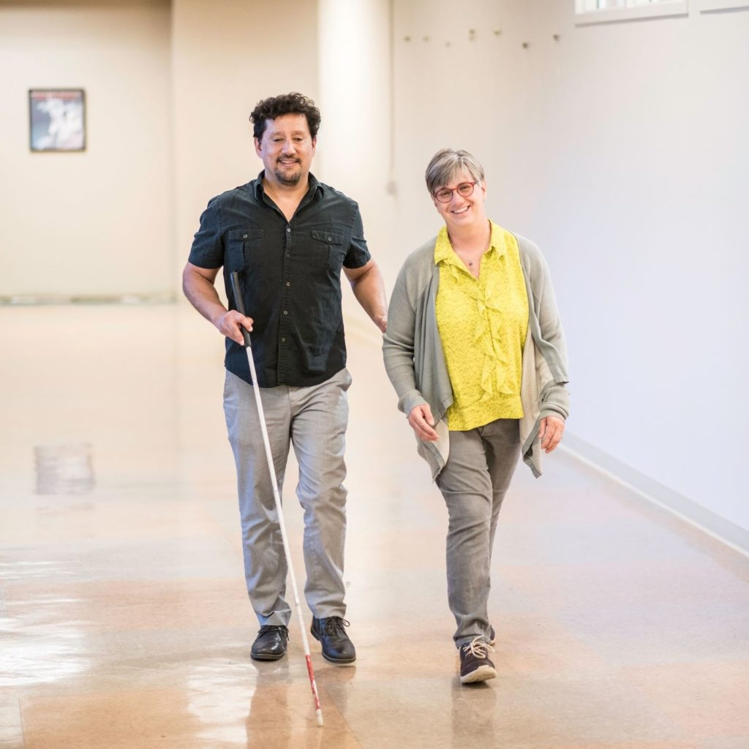
Sighted Guide with a Cane
The learner should hold the cane in their free hand while using sighted guide with the other
The learner may have to switch the side of the cane in presence of doorways or handrails on stairs
Learner may use the cane as usual, hold it in “not in use” position or hold it in “diagonal” position

Slide 19
Conclusion
Empowerment
Advocacy
Confidence

Slide 20
Resources
Centre for Excellence in Universal Design - Centre for Excellence in Universal Design
Human-Guide-Technique.pdf
How to be an effective human guide – Perkins School for the Blind
Human Guide Techniques – Helen Keller Services
Orientation and Mobility Techniques: A Guide for the Practitioner; 2nd Edition by: Diane L. Fazzi and Janet M. Barlow

Slide 21
Q&A

Slide 22
Thank you for joining us!
This session has now ended

