Slide 1
Steering Committee
History of CCAC
Mission & Philosophy
CCAC Organizational Flow
Steering Committee Expectations
What programs do SC members support?
Perspectives from current members
Questions from the audience!
Notes:
Hillary to cover Slides 1-8, 16, 20-21
Emma to cover slides 9-15, 17-19
SC perspectives from Risa, Clare, Emma, Hillary, any addtl SC members present who want to share
Transition to Questions from the Audience submitted via CHAT or shared via microphone

Slide 2
History of CCAC
The Beginnings (2013-2015)
Equipment Loan Program (2016)
Non-profit incorporation (2018)
New initiatives & Strategic Planning (2020)

Slide 3
Mission & Philosophy
To empower Chicago’s cultural spaces to become more accessible to visitors with disabilities
How do we serve this mission?
Acknowledge that everyone is at different places on their access journey
Incremental change leads to lasting change
Positive encouragement and striving to go beyond compliance
Volunteer-run at every level of the organization

Slide 4
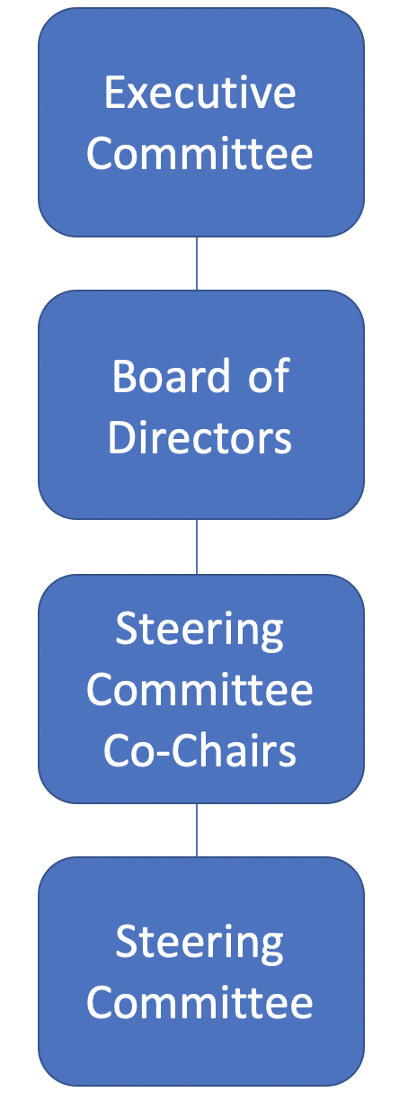
Organizational Flow
Executive Committee of the Board
Can act on behalf of the board
Oversees Co-Chair selection
Meets regularly with current Co-chairs
Board of Directors
Oversees legal and fiduciary responsibilities
Relationship and partnership building
Fundraising and grant writing oversight

Slide 5
Organizational Flow Cont...
Steering Committee Co-Chairs
Oversees day-to-day work of CCAC and SC
Maintaining financial records and tracking
Ensures program goals are mission-based/obtainable
Steering Committee Members
Oversees planning, execution, support of mission-based
programming
Builds relationships with cultural orgs & disability communities
Support other administrative needs as necessary

Slide 6
Steering Committee Expectations
Qualifications for Applicants (not an “all or nothing” deal)
Experience with program creation, admin skills, knowledge of accessible technology
Professional or personal experience with disability and accessibility at cultural institutions
Have a passion for making cultural spaces more accessible, are a great communicator, and are able to manage your time independently
CCAC values the experiences of people who have disabilities; individuals with disabilities are encouraged to apply

Slide 7
Steering Committee Expectations
Term Details
SC members commit to a 2-year term
Involvement with subcommittee assigned on annual basis
Status/Progress check-ins with Co-chairs
Opportunity to remain on the SC for additional term(s) upon annual review and goal-setting with Co-Chairs

Slide 8
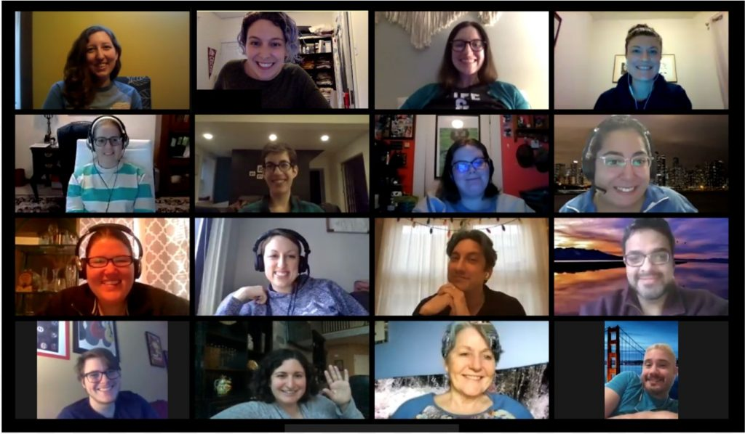
Steering Committee Expectations
Time Commitment & Additional Responsibilities
Monthly SC Meetings (in-person or via conference/virtual), attend PD events
Participation in additional subcommittee communication and meetings
Email communication is a MUST, with high rate of response time
Leadership Areas
Programming PD Topics
Leading PD Programs
Subcommittee Leads
Examining/improving processes

Slide 9
Access Calendar
CCAC maintains a calendar of accessible events presented all over the Chicagoland area.
Organizations submit events and indicate which accessible services will be provided.
Events are reviewed by Access Calendar team (1 lead, 2 supports)
Events are put into CCAC’s online Access Calendar. Also shared on a monthly basis by The League of Chicago Theatres

Slide 10
Equipment Loan
CCAC offers free short-term equipment loans to Chicago-area cultural organizations.
We help support organizations that are interested in access, but may not have the funds to support buying accessible technology. You can borrow from us and prove to your colleagues that it is worth it!

Slide 11
Equipment Loan
CCAC maintains an inventory of equipment at the Peggy Notebaert Nature Museum, which then is used all over the Chicagoland area.
Organizations submit requests through EL process on our website
Requests are reviewed by Equipment Loan team and required paperwork distributed to organization
Requests are then confirmed/coordinated

Slide 12
Equipment Loan
Types of equipment available:
Stationary Audio Description Kit
Stationary Assistive Listening System
Portable FM Assistive Listening System
DIY Captioning Equipment

Slide 13
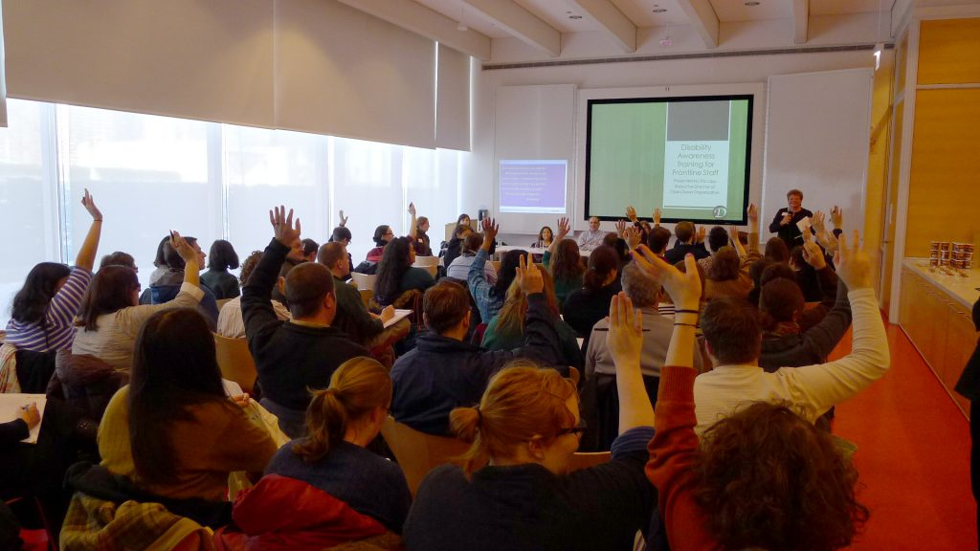
Professional Development
CCAC has offered over 40 educational programs engaging more than 2,000 cultural administrators.
Zoom has allowed us to expand our reach to engage both audiences and speakers from outside of
the Chicagoland area!

Slide 14
Professional Development
Types of trainings offered:
Intro to accessibility
Deeper dives into specific topics
Book club style events - where participants are encouraged to read or watch something before attending.
Lunch and Learns - casual conversations with peers on topics
Socials - opportunities to meet others in the field of access

Slide 15
Professional Development
The desired audience for programs differs based on content (museum professionals, theatre professionals, gallery spaces, educational staff)
We want professional development to be engaging and not too intimidating for anyone! It’s all about the incremental changes!

Slide 16
ICAN Initiative
Illinois Cultural Accessibility Network (ICAN) is a state-wide volunteer network connecting arts and cultural organizations to become more accessible to people with disabilities and older adults. ICAN is made possible through funding from the Illinois Arts Council Alliance.
We have a calendar of professional development opportunities which is specifically meant to engage those in all of Illinois doing or interested in accessible cultural work. Goal is to create more leadership in accessibility and invite allies across the state to be part of the planning and execution.
Notes:
Hillary does 16--ask Brittany for any additional notes

Slide 17
Fundraising and Grant Writing
Interested steering committee members can help with seeking out funding or grant opportunities, creating smaller funding events
SC members also assist with reconciliation of annual fund gifts, such as writing thank you notes, some light bookkeeping
We also host at least one large fundraising event each year, solicitations and getting the word out is a critical communication piece for CCAC!
Notes:
Emma does 17--ask Risa for any additional notes

Slide 18
Social Media
Promoting CCAC Professional Development work (including possibly managing social media accounts)
Twitter
Facebook
LinkedIn
Sharing material on social platforms, or personal platforms, so that CCAC’s pages stay visible
Notes:
Emma

Slide 19
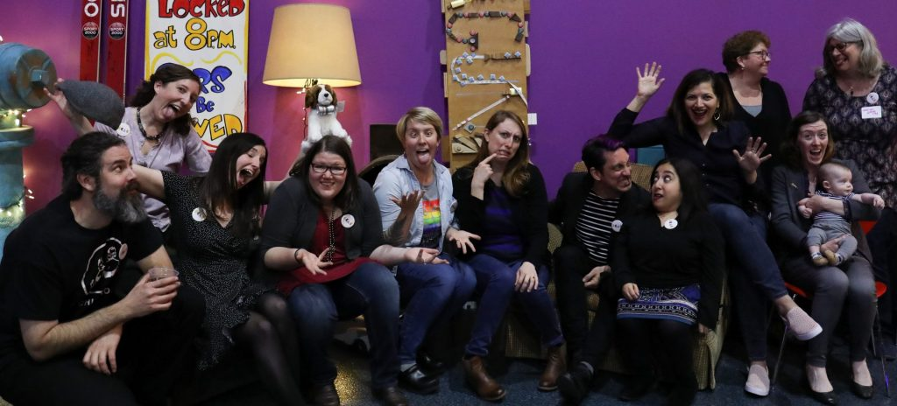
Most importantly...
Involvement with the CCAC Steering Committee is about collaborating with passionate peers in a fun, open environment who are all advocating for the same thing--the inclusion of more people in cultural experiences!

Slide 20
Perspectives from current members
Why did you join the Steering Committee? What keeps you engaged?
What professional development growth or skill set has involvement with the Steering Committee helped develop or hone for you?
What areas of leadership in CCAC are the most exciting for you? How has CCAC built or contributed to your "access allies" network and/or toolkit for your organization?

Slide 21
Questions?
If you have any questions or are interested in learning more about what we do, email info@ChicagoCulturalAccess.org
The Call for Applications Material is found in the CHAT and will also be emailed out to everyone.
Application period opens today and will be sent out via the Chicago Cultural Access Listserv. Deadline to apply is Wednesday, March 31st.

