Slide 1
ADA 101: The ADA & Cultural Spaces
Robin Jones, Director
Great Lakes ADA Center
University of Illinois at Chicago

Slide 2
Agenda
Discussion of the ADA as a Civil Rights Law/Background
Introduction of Panelists
Effective Communication
Reasonable Accommodation/Modification of Policy and Procedures
Architectural Access
Enforcement
Questions

Slide 3
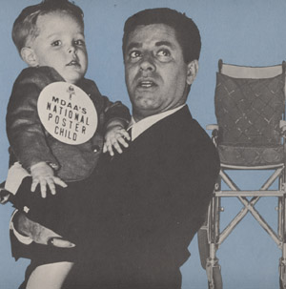
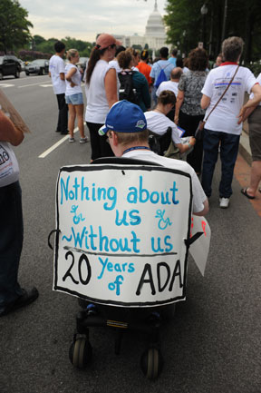
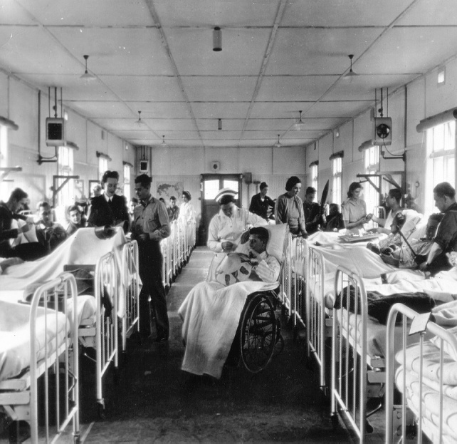
Shifting Paradigms
Charity Model
Civil Rights
Medical
Model
Moral Responsibility

Slide 4
How Far Have We Come?
From not being welcomed to……..
….positive marketing

Slide 5
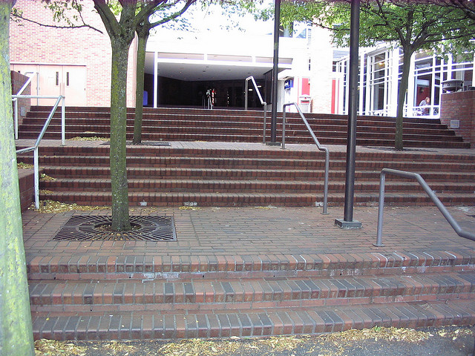
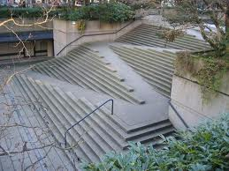
How Far Have We Come?
From no access………
…..to Universal Access

Slide 6
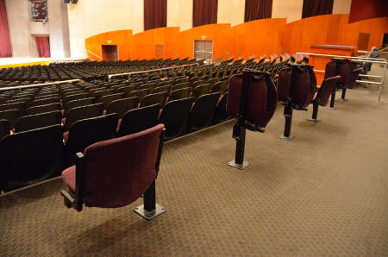
How Far Have We Come?
From no wheelchair seating……..
…to integrated seating.

Slide 7
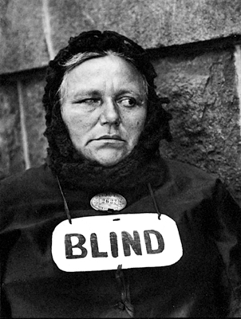
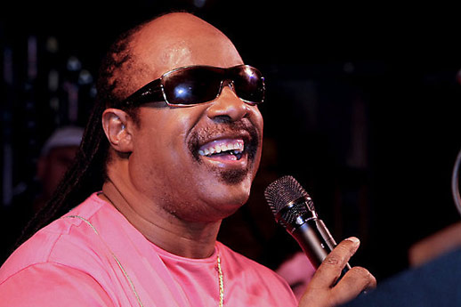
How Far Have We Come?
From beggar………
……to celebrity status

Slide 8
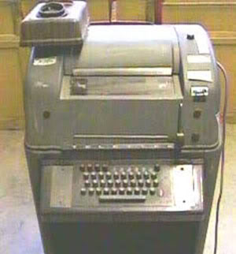
How Far Have We Come?
From clunky specialized technology to…..
….to mainstream technology
1950’s era TTY
iPhone Facetime

Slide 9
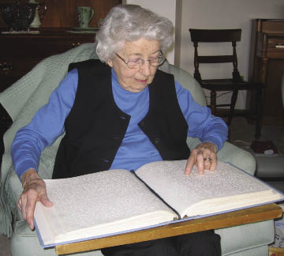
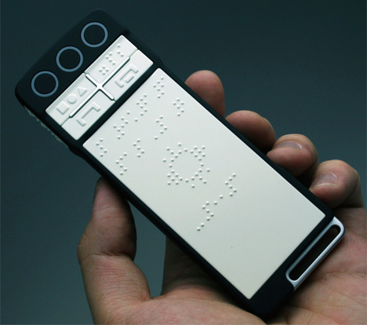
How Far Have We Come?
From volumes of Braille to………
….handheld refreshable Braille device

Slide 10
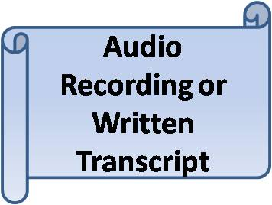
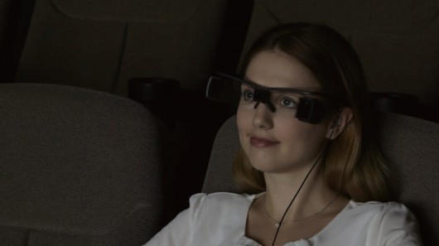
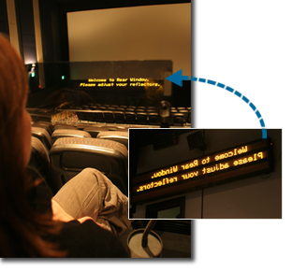
How Far Have We Come?
…..to unlimited possibilities
From limited options……..

Slide 11
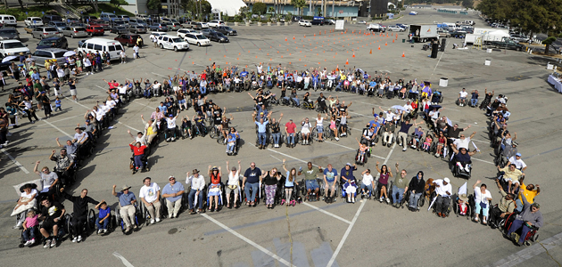
Americans with Disabilities Act 1990

Slide 12
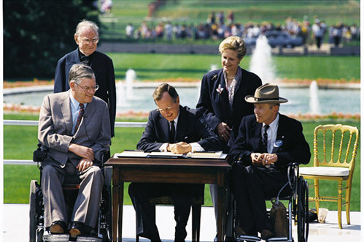
Purpose of the ADA
Prohibit discrimination on the basis of disability
Integration vs Segregation
Equality of Opportunity

Slide 13
ADA Facts you should know……
Based on Section 504 of the Rehabilitation Act
Same definitions, etc.
Applies to covered entities regardless of where their funding comes from
Exemptions:
Religiously controlled and operated entities
Tribal Entities (those with recognized treaties)
Private Clubs (those that meet the IRS definition)
Federal Government

Slide 14
Main Titles of the ADA
Title I – Employment
Private employers with 15 or more employees
Public employers with 1 or more employees
Title II – Local and State Government Entities
Publicly owned and operated facilities -Theatres, Museums, Zoos, Parks, Convention Centers, etc.
Title III – Places of Public Accommodation
Privately operated facilities - Theatres, Museums, Zoos, Parks, Convention Centers, Restaurants, Retails stores, hotels, etc.

Slide 15
Additional Titles
Title IV – Telecommunications
Telephone Relay Services
Publicly funded Public Service Announcements
Title V – Miscellaneous Provisions
Retaliation
Attorney’s Fees
Insurance
Etc.

Slide 16
Today’s Panelists
Christena Gunther – Elmhurst Historical Museum
Evan Hatfield – Steppenworlf Theatre
Lynn Walsh – Chicago Children’s Museum
Philip Dawkins – Playwright

Slide 17
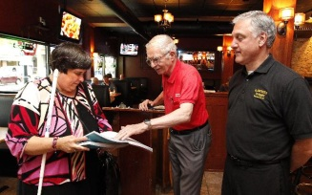
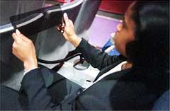
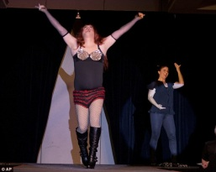
What is Required?
Auxiliary Aids and Services/Effective Communication
Provide alternative formats of print materials
Braille
Large Print
Audio/Digital taped
Electronic format
Provide Different forms of communicating aurally and visually delivered information
Sign Language Interpreters
Real-Time Captioning
Assistive Listening Systems
Audio Description
Unless it would be a fundamental alteration or undue burden/hardship

Slide 18
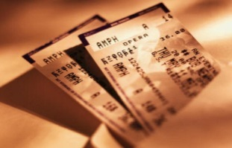
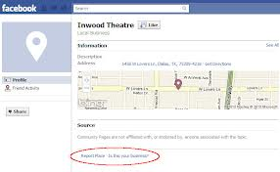
When is it Required
Advertisements/Promotions
Website/Electronic Communication
Fliers
Newspaper Ads
Radio Announcements
Social Media
Communication with the Venue
Telephone/Text
Email
Face-to-Face
Social Media Postings

Slide 19
Technology Issues
Accessible Information Technology
Website and web based information /transactions
Social Media
Internet based applications and/or services
For Local/State Governments (Title II)
Part of the “programs” offered or method of delivery
For Places of public accommodation (Title III)
Service and/or a method of conducting business with the public
Pending regulations 2014

Slide 20
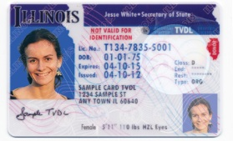
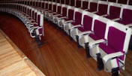
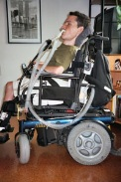
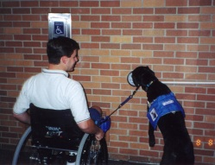
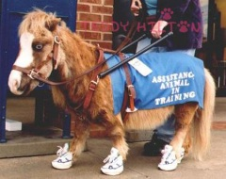
What’s Required?
Accommodations/Modify policies and procedures to ensure equal access
Permit use of Service Animal
Accept State ID versus Drivers License
Consideration of seating due to disability (not just wheelchair seating)
Allow food or drink where otherwise not allowed
Allow use of other paths of travel to get to areas within the venue
Allow individuals to “do it differently”
Unless it would be a fundamental alteration or undue burden/hardship

Slide 21
Alert : Ticketing Issues
2010 ADA Regulation Changes
Availability
Same hours, methods, etc.
Pricing/Number of Tickets Sold
Sell up to 3 additional seat with wheelchair seat
Adjacent if possible (including w/c and companion seats)
Hold and Release
Hold w/c seats until all other sold in seating area
2nd Market Ticket Sales
Treat same as others – exchange for accessible if available
Fraud Prevention
Allow attestation to the need for accessible seating

Slide 22
What is Required ?
Architectural Accessibility
Existing Facilities
Readily Achievable Barrier Removal
Little time and little expense
Priorities for Barrier Removal
Getting to the door
Getting around inside the building/facility
Restrooms
Other amenities (water fountain, alarms, etc.)
Obligation to remove barriers is on-going

Slide 23
Architectural Access (con’t)
Historic Structures
Remove barriers unless they would destroy the historic nature of the building/element
Must be on local/state/national historic registry
Alternative options for access need to be identified
New Construction/Additions
New Standards – March 12, 2012
All required features must be accessible
Alterations
Areas being altered must meet 2010 ADA Standards

Slide 24
How Do I know if I am Accessible?
Governmental Entities
Self-evaluation plan
Review/modify policies and procedures as necessary
Transition Plan
Identify architectural barriers and remove as necessary to create access
Private Entities
Review facilities (or have someone else do it) to Identify architectural barriers
Remove if “readily achievable”
Create a “Plan” for removal if barriers require long term changes
Identify alternative methods of service delivery if architectural access cannot be achieved

Slide 25
Tax Benefits
IRS Code 190: Architectural and Transportation Barrier Removal
Installing lifts on vehicles, restriping parking lots, widening doors, ramping entrances, signage, etc.
$15,000 Maximum/YR
IRS Code 44: Disabled Access Credit
Sign language interpreters/Captioning, assistive listening system, removing architectural barriers
Small Business - $1,000,000 or less gross revenue and/or 30 or fewer employees
$5,000 maximum/YR .50 on each $1.00 spent

Slide 26
Enforcement
Local and State Government
U.S. Department of Justice or designated agency
800-514-0301
www.ada.gov
Places of Public Accommodation
U.S. Department of Justice or designated agency
800-514-0301
www.ada.gov
Individuals may file “Private Right of Action” against public and private entities (with exception of Employment)

Slide 27
Intersection with Other Laws
Entities may be covered by both Section 504 and the ADA
Different enforcement mechanisms
Different Remedies
Local or State laws may be more “stringent” than the ADA or Section 504
The law which provides the greater access to persons with disabilities prevails
Know your local/state laws!

Slide 28
Thoughts to take away today….
Learn the laws but do not let them limit you!
Laws are the starting point…..you and your agency can go beyond the minimum!
Never stop……creating an environment that is open and accepting of everyone requires constant diligence to maintain!

Slide 29
Questions?
Contact information:
Chicago Cultural Access Consortium
http://chicagoculturalaccess.weebly.com/
ChicagoCulturalAccess @ gmail.com
Facebook

