Slide 1
Emergency Planning - An All Purpose Guide -
Vince Gortner
Director of Visitor Operations
The Morton Arboretum
Lisle, IL

Slide 2
Opening Slide
Put something interesting here

Slide 3
Emergency Planning
Let me start with a few moments of stand-up comedy generally intended to…
Tell you why I’m marginally qualified to talk about this.
Help you manage your *hopefully low* expectations for this session.
And provide some insight into the planning process and how we got here.

Slide 4
The value of planning
Failing to plan is planning to fail.
- Alan Lakein

Slide 5
The value of planning
No battle plan survives first contact with the enemy.
- Field Marshal Helmuth Karl Bernhard Graf von Moltke

Slide 6
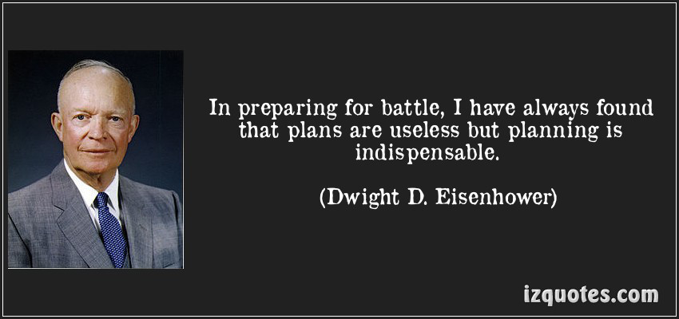
The value of planning

Slide 7
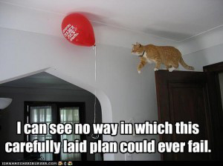
The value of planning

Slide 8
Emergencies can be stressful
Fire (get outside!)
Severe weather (get inside!)
Flooding (get some towels!)
Armed bad person (get…. invisible!)

Slide 9
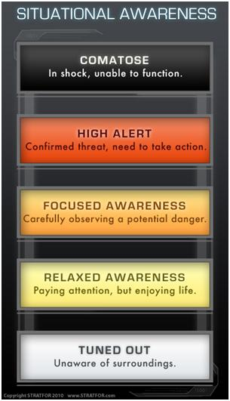
High Stress
Eustress – good stress, appropriate, beneficial, and not boring.
Stress levels?
A little more can be good.
Situational awareness
Stress beyond your capacity to deal with what is happening!

Slide 10
Physiological effects of stress
Tunnel vision
Auditory exclusion
Loss of fine motor skills
Basically…
Simple things become difficult
Difficult things become impossible
People will fall back on their training

Slide 11
When to train, how to train?
Training can be good!
Comfort in repetition
Comfort in three-ring binders
Comfort in “we have a plan”
But training must allow flexibility

Slide 12
FBI shootout Miami, Florida 1986
Bad guys, bank robbers
Bad guys had better guns
FBI outnumbered bad guys 8 to 2
Rigid FBI training vs. combat experience in Vietnam
It was a bad day for the FBI.
Under extreme stress, people fell back on their training.

Slide 13
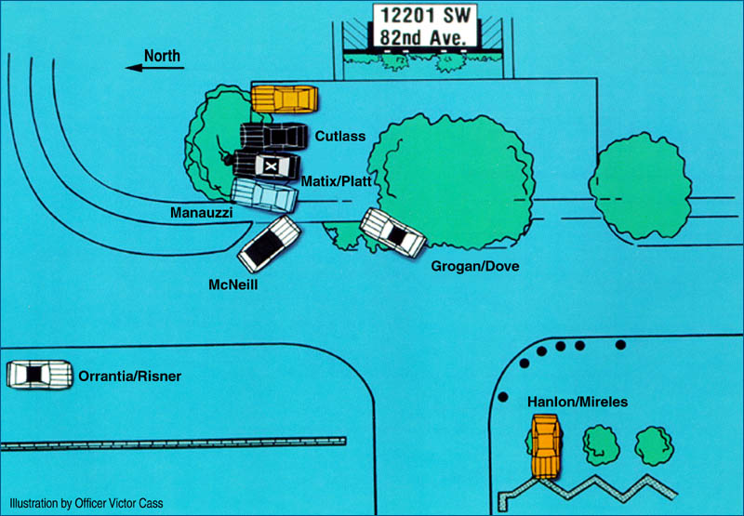
Where did they go wrong?

Slide 14
wait
What does an FBI shootout in Florida in the late 80’s have to do with fire drills?
Who are you again?

Slide 15
The Morton Arboretum
Horticultural museum
Founded by Morton Family in 1922
1,700 acres
1,000,000 visitors per year
Education programs, science center
Special events, concerts
Mostly outside

Slide 16
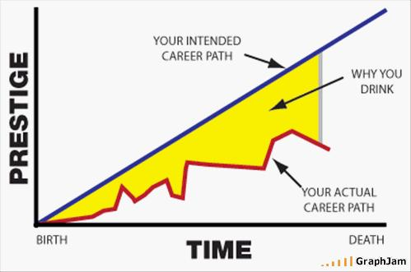
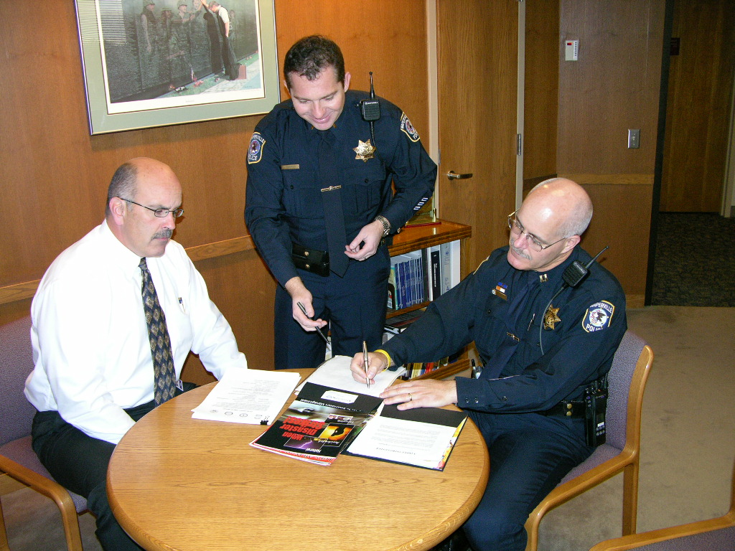
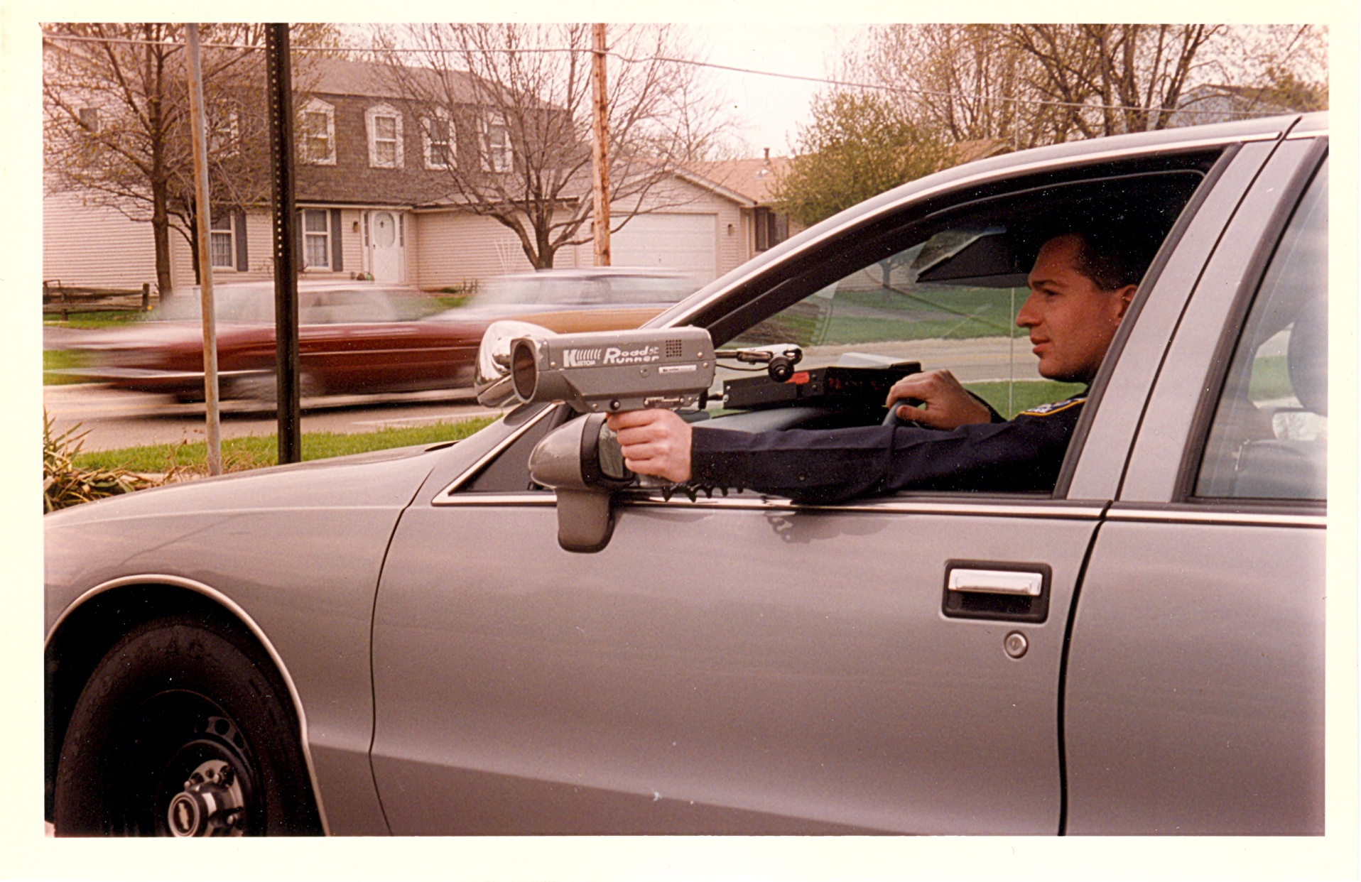
Naperville Police Department
Mechanical engineer
Traffic accident reconstruction
Attempted to solve problems by getting promoted
Equivalent to drilling holes in the bottom of your boat to let water out
2007-2013 Deputy Chief of Police
Planning, training, R&D, accreditation

Slide 17
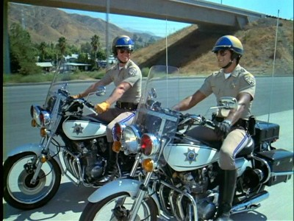
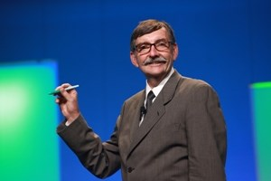
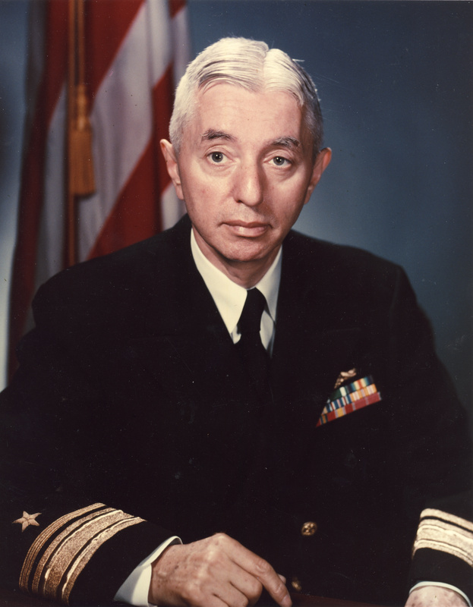
Gordon Graham
CHiPs
Law school
Office of Professional Standards
Analysis of litigation
Risk management!
Admiral Hyman G. Rickover
Predictable is preventable

Slide 18
Risk Management Timeline
Incident
(past)
(future)
X
Planning
Training
Safety policies
Employee involvement
This is Risk Management
Medical Treatment
Workers Comp Claims
Lawsuits
Writing of checks
This is post-incident correction

Slide 19
Risk and Frequency
So what do we worry about?
What should we be worrying about?
What should we do INSTEAD of worrying?

Slide 20
Risk and Frequency
High risk &
low frequency
High risk, but
High frequency
Things that can go wrong
Risk
Threat
Liability
Danger
Low risk
Frequency
How often do we deal with this?

Slide 21
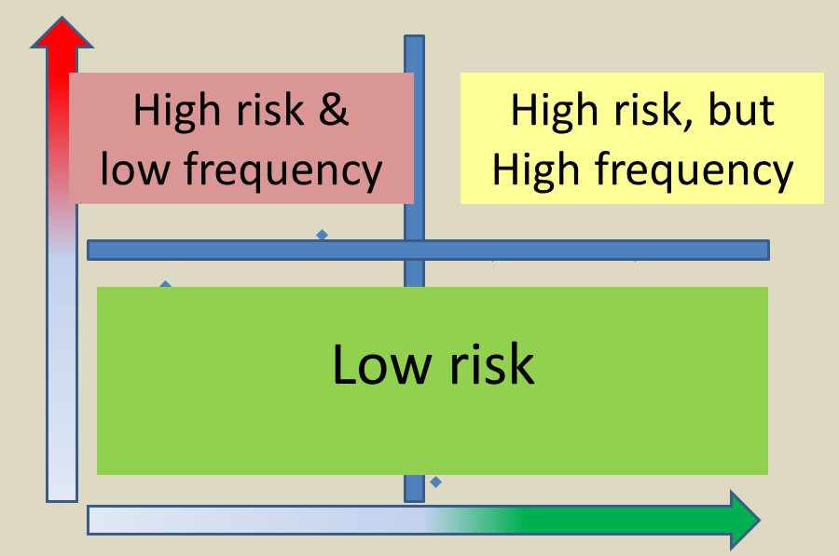
What about time?
No discretionary time
Discretionary time

Slide 22
Emergency Planning
Adding the luxury of time
Discussion of situational assessment
Identify or develop resources
Debate options for action
Document and share information
Framework for training

Slide 23
Planning and Training
We must go back to the opening quote
Impossible to plan for every situation
Would not want to anyhow
Cumbersome, overcomplicated
Does not incorporate agility, situational awareness
Training in this manner would be detrimental!
No battle plan survives first contact with the enemy.
- Field Marshal Helmuth Karl Bernhard Graf von Moltke

Slide 24
Planning and Training
Remember the FBI thing?
Training was TOO structured
TOO rigid
Did not allow for plan changes in a
dynamic and rapidly evolving environment.

Slide 25
FBI shootout Miami, Florida 1986
Bad guys, bank robbers
Bad guys had better guns
FBI outnumbered bad guys 8 to 2
Rigid FBI training vs. combat experience in Vietnam
It was a bad day for the FBI.
Under extreme stress, people fell back on their training.

Slide 26
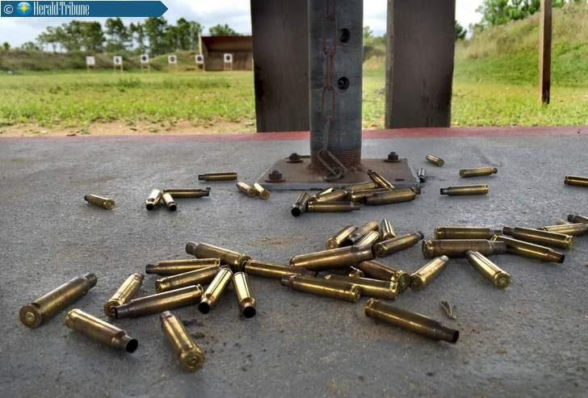
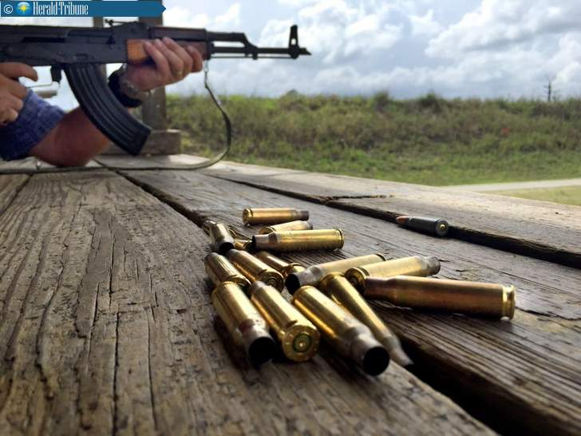
FBI shootout
Reloading gun? Only one way to do it!
Gun stopped working? Let’s fix it right now!
Keep your work area neat and tidy.

Slide 27
Flexibility
Let people make decisions for themselves
Keep primary objective in mind
Allow for the unexpected
In fact… create the unexpected if you can.

Slide 28
The “All-Hazards” Plan
Flexibility is the key
Having the right people in place
Handing them resources
Empowering them to make decisions
Giving them tools to communicate in real-time
Bonus points: Calm leadership during crisis

Slide 29
The “All-Hazards” Plan
Infinitely valuable:
Planning with first responders
Coordination with first responders
Training with first responders
Be good public safety customers!
Make some new friends today.

Slide 30
Hey – What about the planning part?
Identify the scariest things that could happen.
No discretionary time.
Wake up at 3:00 a.m. in cold sweat.
Talk to people, have a meeting.
Seriously. What would we do.
What could we do? Options?
What would police/fire suggest?

Slide 31
Narrowing the plan
Identify some really good options
More than one
Leave plan open to other options
First line supervisors are the glue, so get them involved at ground level.
Less is more
Tabletop exercises, Gedankenexperiment
Red team

Slide 32
Firming up the plan
Plan covers 80%-90% of what could happen
Be really creative
Don’t freak out, you have time
Now
You won’t later
No sticking head in sand

Slide 33
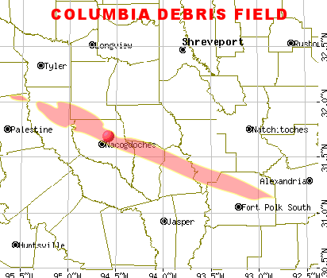
Columbia Space Shuttle
I am a geek
"Are people just relegated to crossing their fingers and hoping for the best?"
-Bob Daugherty

Slide 34
Firming up the plan
Plan covers 80%-90% of what could happen
Be really creative
Don’t freak out, you have time
Now
You won’t later
No sticking head in sand
Accessibility
Partnership with first responders
Keep it simple

Slide 35
Communication & Training
Get supervisors on board
Communicate
Overcommunicate – multiple channels
Practice (announced)
Practice (surprise)
Repeat, reinforce
Plans and training must evolve
Don’t stick with a bad plan

Slide 36
Repeat until done
Fire
Severe weather
Environmental threat – HazCom
Mass casualty
Workplace violence
Aimed at specific employee
Angry employee
Other unthinkable things

Slide 37
Some thoughts about…
Active shooter
Worst case scenario
No one single solution
Training materials
Run, hide, fight video
Individual course of action
Communication with police
Google “dhs active shooter how to respond”

Slide 38
Thank you!
vgortner@mortonarb.org
630-725-2099

