Slide 1
Twenty minutes of autism. what it means. what it really means. how you can help.
Katie Hench, Infiniteach

Slide 2
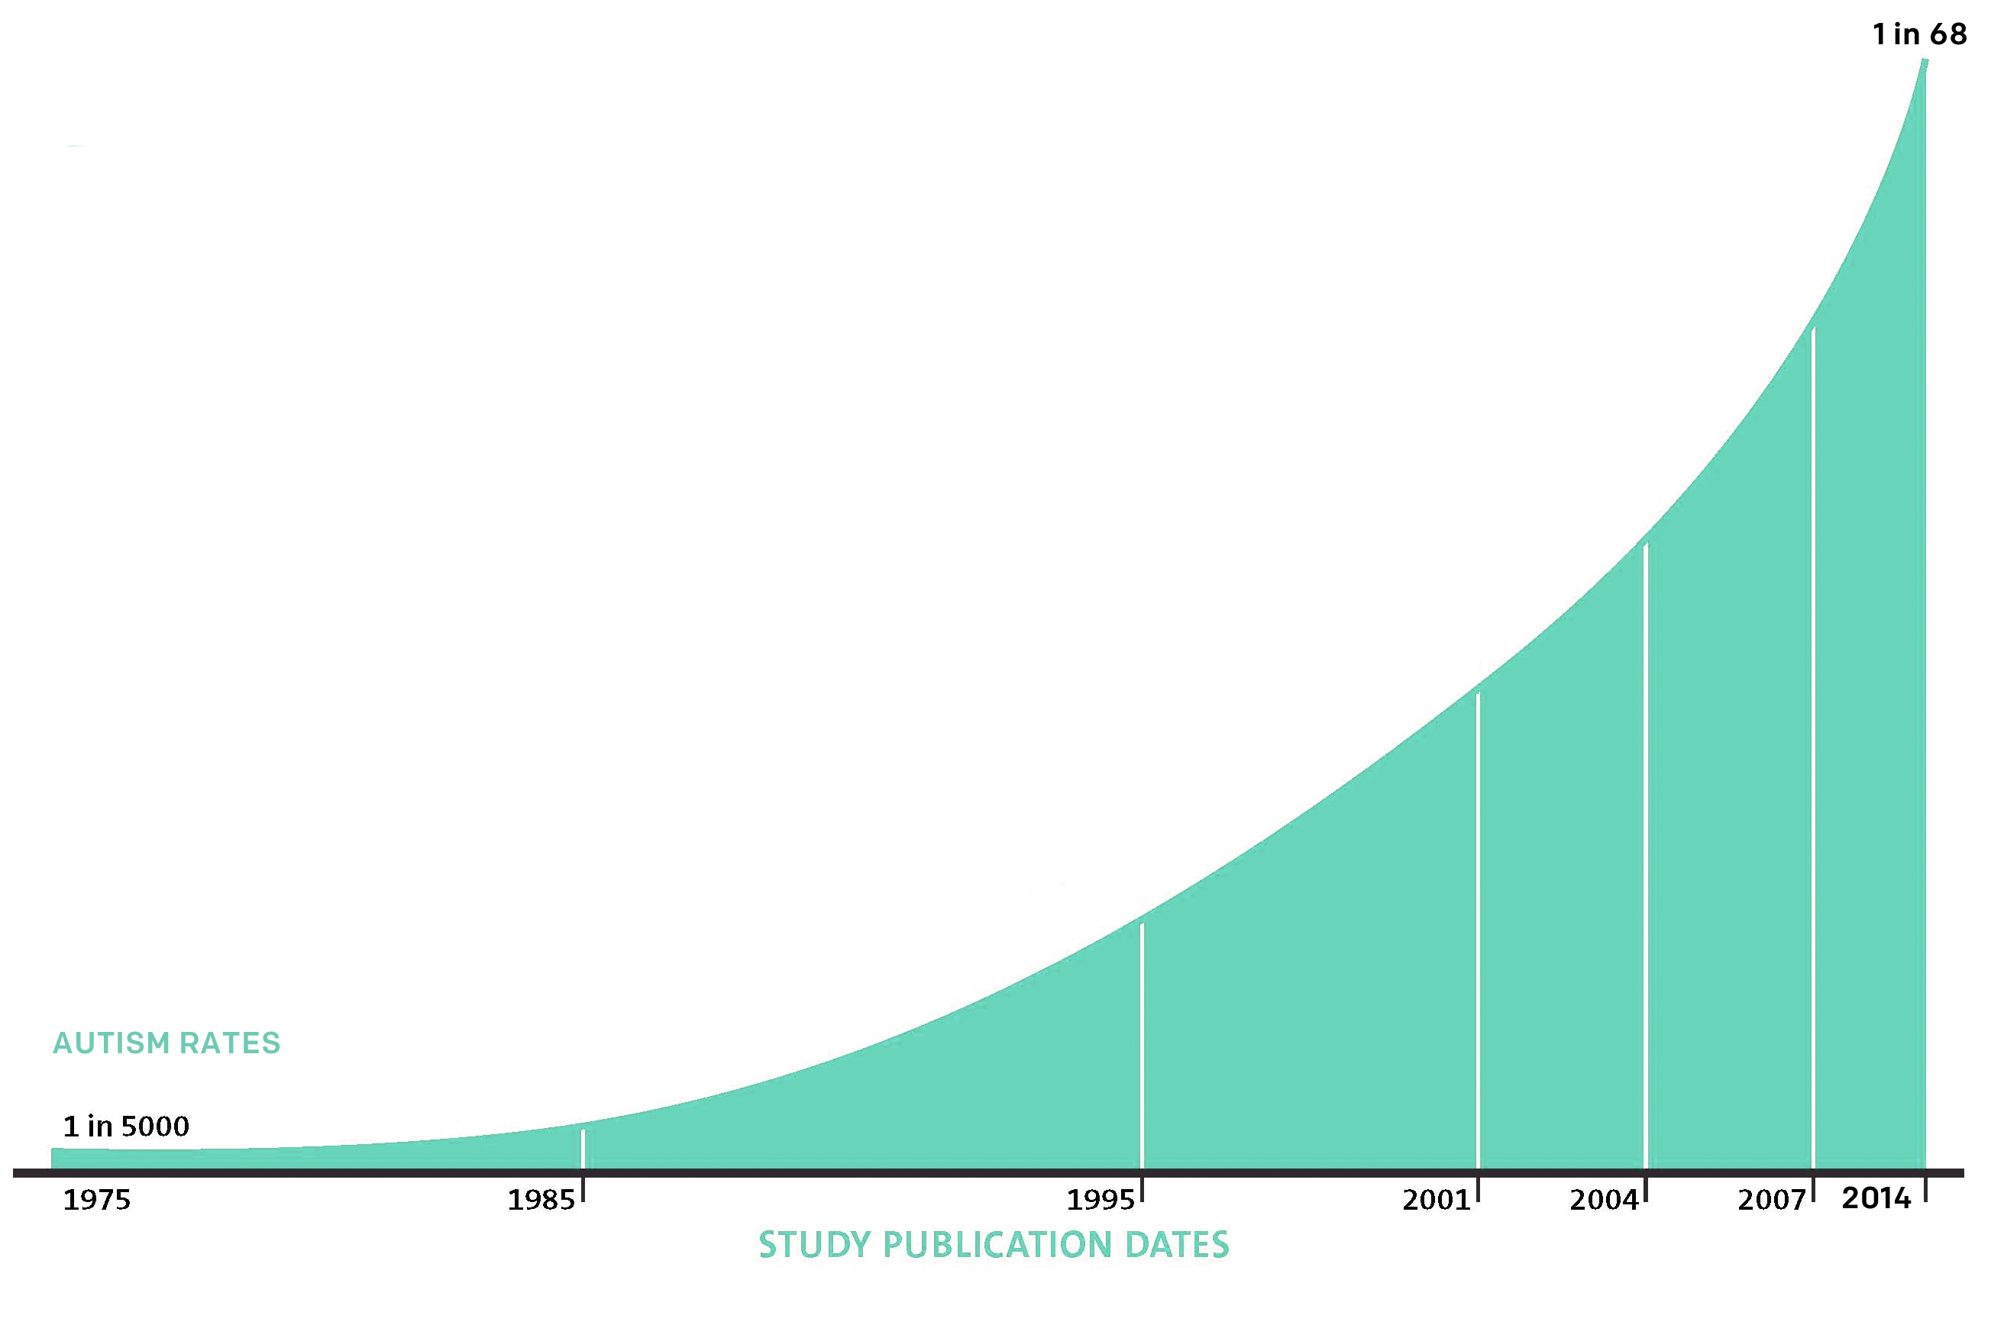
Autism Prevalence
Current research indicates 1 in 68 children are diagnosed with Autism Spectrum Disorder (ASD)
An autism diagnosis affects the individual, as well as their family and support network

Slide 3
DSM V Definition
Persistent deficits in social communication & social interaction across multiple contexts
Restricted, repetitive patterns of behavior, interests, or activities

Slide 4
Autism Characteristics
Social Engagement
Repetitive Movements
Need for Routines
Fixated Interests
Hyper or Hypo-Sensory Input

Slide 5
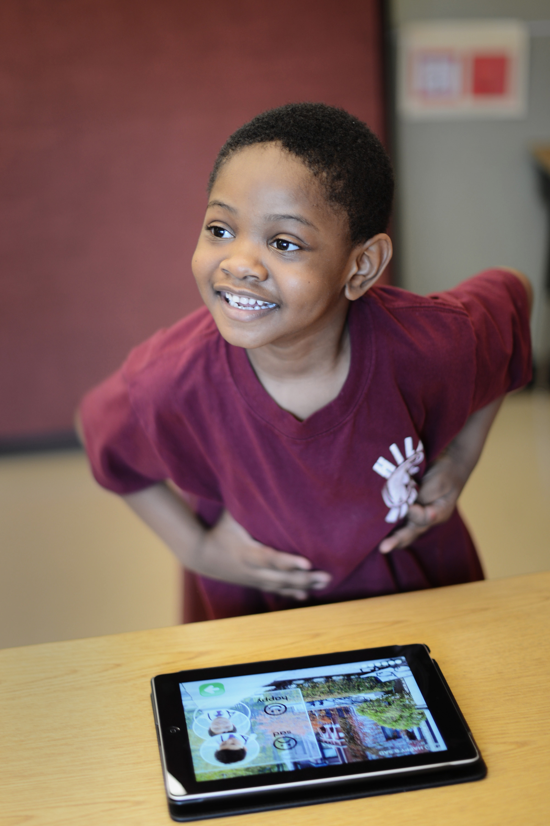
Common ASD Assumptions
Individuals with ASD:
Do not develop speech
Do not make eye contact
Are geniuses
Will not become independent adults
Are not affectionate

Slide 6
Understand the Culture of Autism

Slide 7
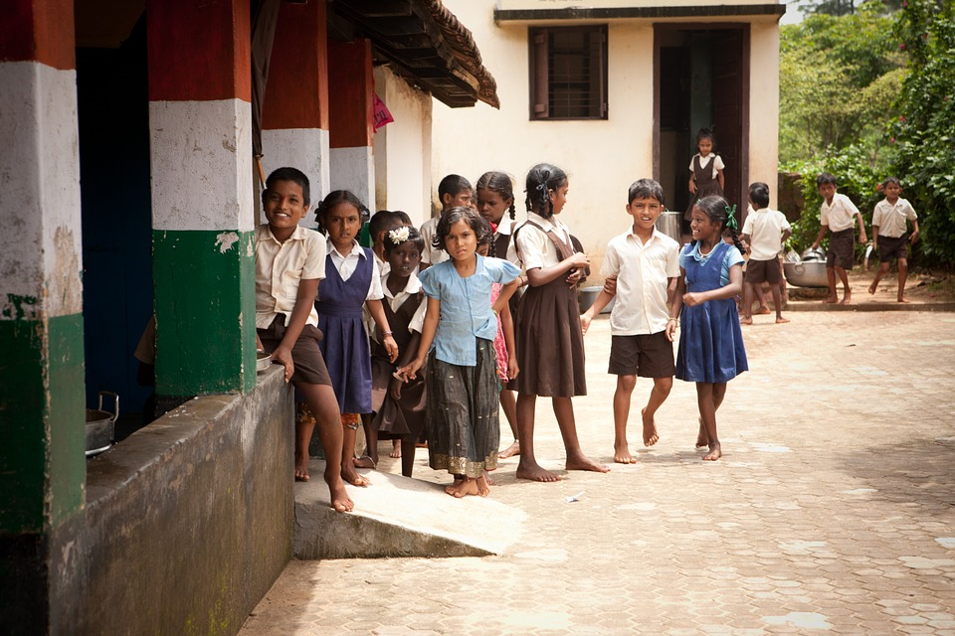
Think of yourself as a Cross Cultural Interpreter
Notes:
CRICKET.

Slide 8
Understanding Behavior
Snu deg rundt og si hei til naboen
Notes:
So when we expect certain behaviors from an individual with autism, and don’t get them, we should consider why. Is it that the individual won’t do what we’re asking out of defiance, tiredness, etc – the things we all have under the waterline, or is it that they can’t do what we are asking because of something caused by their autism – rigidity for routine, obsessiveness, compulsivity, sensory overload…this is an exercise we do with educators at our trainings…

Slide 9
Understanding Behavior
Snu deg rundt og si hei til naboen
Turn around and say hello to your neighbor
Notes:
So when we expect certain behaviors from an individual with autism, and don’t get them, we should consider why. Is it that the individual won’t do what we’re asking out of defiance, tiredness, etc – the things we all have under the waterline, or is it that they can’t do what we are asking because of something caused by their autism – rigidity for routine, obsessiveness, compulsivity, sensory overload…this is an exercise we do with educators at our trainings…

Slide 10
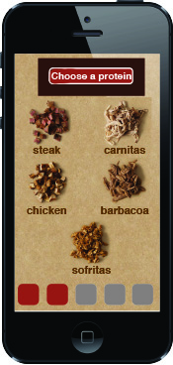
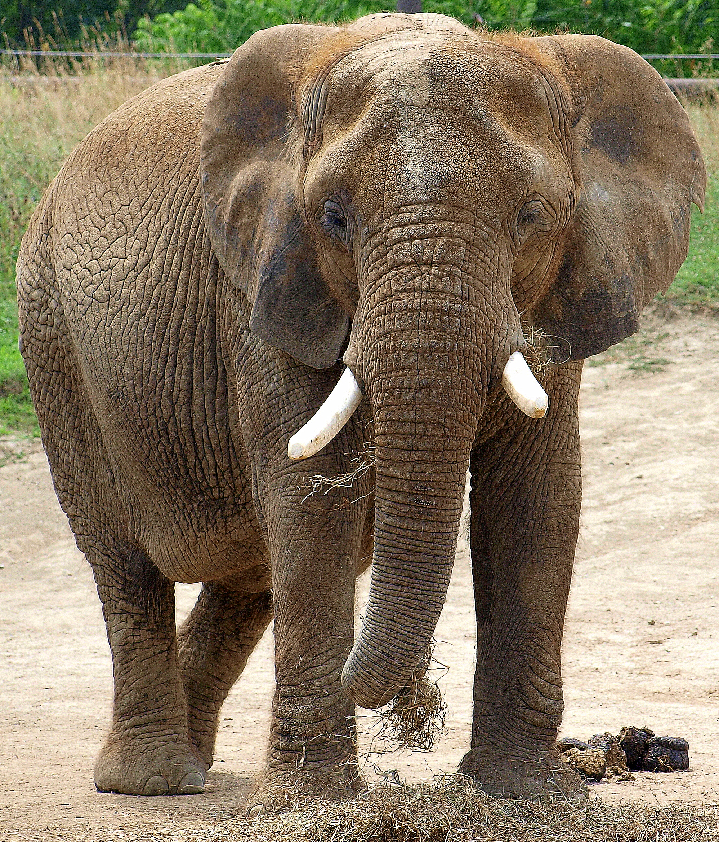
So how can you help?
My Schedule
Scavenger Hunt!
Now:
Coal Mine
Provide structured, visual supports
Offer sensory options
Train ALL staff
Try to Find:
Next:
Bathroom
Later:

Slide 11
Thank you for being autism accessible!
Katie Hench
Infiniteach
khench@infiniteach.com
Notes:
I believe autism is it’s own culture. For all of us, our behaviors are like an iceberg. What we see, the observable behavior, only a small part. What causes that behavior is unseen, below the waterline. For me, right now, what could be causing some of my behaviors might be sleep excitement at being in CA instead of freezing cold Chicago…sleep depravation from havign a 4 month old…for a person with autism, this is no different. Only more complex. Beneath their water line…

