Slide 1
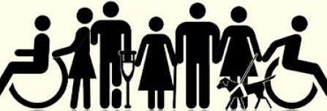
Accessibility 101
Brittany Pyle Director of Production and Audience Experience Chicago Humanities Festival
Anna Cosner Director of Retail and Events The Morton Arboretum
Notes:
Anna - general welcome and intro to CCAC

Slide 2
Why should cultural organizations be accessible? Think of 5 reasons.
Notes:
Brittany
It’s the law
It’s the right thing to do
Organizational mission
Good business sense
Selfish

Slide 3
1. It’s the Law Section 504 of the Rehabilitation Act of 1973 Americans with Disability Act 1990 New regulations under the ADA 2010 New regulations for Effective Communication 2011 Coming next: website regulations
Notes:
Brittany
It’s not just a nice gesture – it’s the law.
Might notice how relatively “recent” those laws were enacted. Revisions have relied partly from input from the public.
Rehab Act of ‘73: It’s applies to recipients of federal $$. Simply prohibiting discrimination on the basis of disability if you receive federal $.
ADA of 1990 – applies to places of public accommodation “If you serve the public, you must be accessible” ---theaters, museums, zoos had to have curbs cut, bumps added to sidewalk intersections, wc stalls
New regs as of 2010 – online ticketing (pricing same and equal); service animals (no comfort animals; miniature horses ok); mobility aids added (Segways, golf carts); changes to # of accessible locations; # ALDs required; changes re: scale of slopes/ramps
New regs for Effective Communication in 2011 – to ensure that a person with vision, hearing, or speech disability can communicate with, receive information from, and convey info to your organization. Businesses that serve the public must provide auxiliary aids and services to communicate effectively with people who have communication disabilities. Businesses must consider the person’s normal methods of receiving communication when providing services (sign language, captions, etc).
Coming next: amendments based on online/web standards

Slide 4
2. It’s the Right Thing To Do As empathetic humans, we know that being inclusive and considering experiences different than our own is a good moral practice.
Notes:
Brittany

Slide 5
3. Organizational Mission Most arts and culture organizations use the words “diversity” “inclusivity” “belonging” “accessible” in their mission statement, so accommodating people who are aging or have disabilities is a natural fit.
Notes:
Brittany

Slide 6
4. Makes Good Business Sense People who receive good customer service (or experience their friends and family receiving good service) will feel included in your org’s values. They will return to you and support you with their wallets.
Notes:
Brittany

Slide 7
5. We are Selfish Each one of us will eventually need accessible accommodations as our bodies age or become injured. Perhaps sooner, someone close to us will need accessible accommodations. We don’t want to inevitably be shut out from doing things we love. So we build accessibility for ourselves.
Notes:
Brittany

Slide 8
1 in 5 Americans has a disability
Notes:
Brittany
Some visible, some invisible

Slide 9
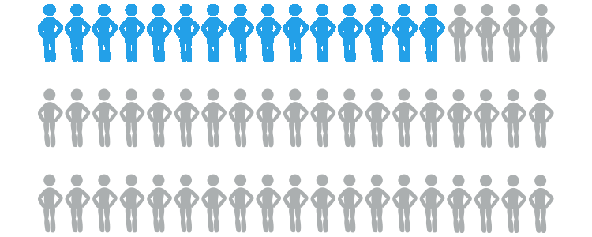
77.3 million Baby Boomers make up 25% of U.S. population
Notes:
Brittany

Slide 10
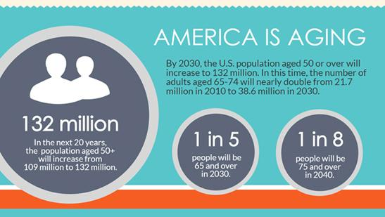
By 2030, more citizens will be over the age of 60
than under the age of 30
Notes:
Brittany

Slide 11
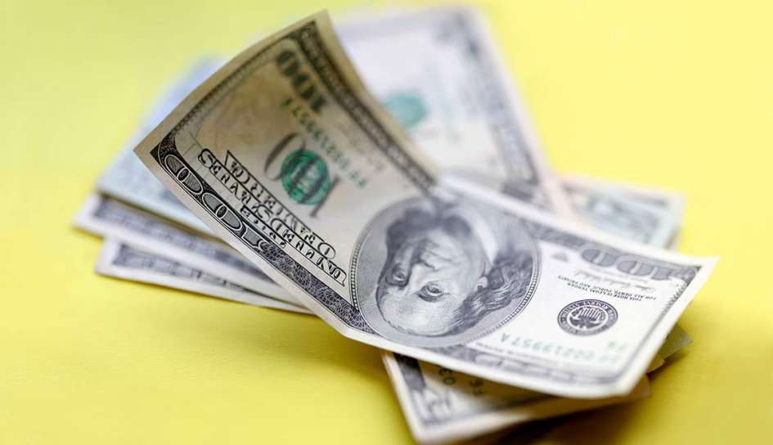
People 55+ years old control more than 75% of America’s wealth, have most disposable income
Notes:
Brittany

Slide 12
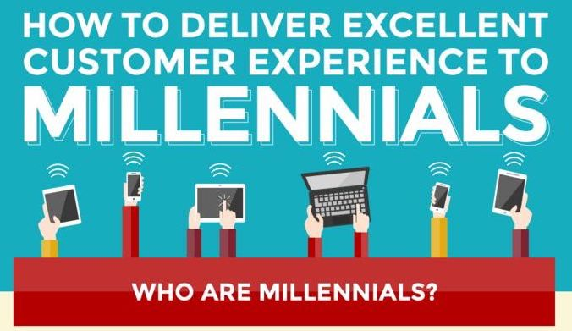
People with disabilities born after 1990 have always known a world with ADA laws in place. They have expectations for complete compliance and equality.

Slide 13
Leads one to believe… Accessibility is an organizational asset!
Notes:
Brittany

Slide 14
What is “disability?”
ADA Definition:
Someone who has, has a record of, or is regarded as having, a physical or mental impairment that substantially limits one or more major life activities (eating, breathing, walking, talking, seeing, etc).
Notes:
Brittany
This is a human rights model. In the past, disability was thought of from a medical model---as in, your doctor diagnosed you as disabled.

Slide 15
How we define “disability”
A person is more or less disabled based on their interaction with the ∙ Physical environment ∙ Communication environment ∙ Information environment ∙ Social and policy environment
Notes:
Brittany
This is a human rights model. In the past, disability was thought of from a medical model---as in, your doctor diagnosed you as disabled.

Slide 16
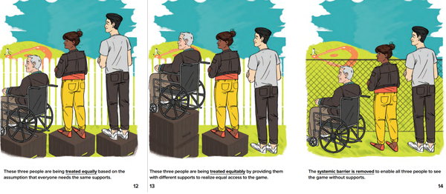
Equal vs Equitable vs Universal Design
Notes:
Brittany
1. These 3 people are being treated equally based on the assumption that everyone needs the same supports. 2. These 3 people are being treated equitably by providing them with different supports to realize equal access. 3. Universal design means that systemic barrier is removed to enable all 3 people to see without supports.

Slide 17
Your organizations can foster access and inclusion by: ∙ Allocating and leveraging resources (budgeting, staff) ∙ Establishing and implementing policy (Access Plan) ∙ Giving or taking authority (training others) ∙ Lead by example and action (marketing, partners, CCAC, LEAD)
Notes:
Brittany

Slide 18
Funding Guidelines Federal, State, and City Grants
Standards to receive grants (via NEA): ∙ artistic quality ∙ how well are you serving your community? ∙ demonstrated ability in reaching underserved community ∙ demonstrated accessibility / has made provisions for people with disabilities
∙ includes people with disabilities as audience members/visitors, employees, and artists on stage/exhibited
Notes:
Brittany

Slide 19
Standards to receive grants: ∙ Must be a 501(c)3 non-profit ∙ Must comply with ADA (title III for public orgs, museums, etc) ∙ Must comply with section 504 of the Rehabilitation Act of 1973
Will fund -equipment (ALDs, captioning equipment, audio description *specify in your budget when applying for grants!
Will not fund -general operating -capital improvements -construction
Notes:
Brittany
Section 504: No otherwise qualified individual with a disability (physical or mental) shall – solely by reason of their disability --- be excluded from the participation in, be denied the benefits of, or be subjected to discrimination by any program receiving federal financial assistance.

Slide 20
Via NEA grant manager: “There is a difference between ADA compliance and the concept of inclusion. We prioritize funding to cultural institutions that ensure their participants with disabilities feel just like any other participant. We look for a holistic approach to inclusion; those who position accessibility as an opportunity and not a deficiency or challenge. We want to support those who hold a great vision for what is possible and successfully sells that vision. Inclusion is more attractive to funders than compliance every time.”
Notes:
Brittany

Slide 21
Your organization will be evaluated by: ∙ Physical accessibility (venues and facilities) ∙ IT accessibility (website, online videos, etc) ∙ Auxiliary aids for mobility, cognitive, hearing, and visual accessibility ∙ Programmatic access (modifications of policies, procedures to increase accessibility)
Notes:
Brittany

Slide 22
How do we get started?
Notes:
Brittany

Slide 23
Ask these questions
Can everyone truly experience and engage with us? Does a person with a disability feel like they are treated the same as someone without a disability? Does a person with a disability feel considered, or like an afterthought, in our space?
Notes:
Brittany

Slide 24
1. Audit the places your guests interact with you.
Venue(s) Entrances that are ramped, not just stairs? Accessible parking? Accessible restroom stalls? Accessible seating? Doors that aren’t too heavy to open when sitting down? Is information provided with only sighted or hearing guests in mind?
“We’re grandfathered in” Building structural changes after 2010 = total ADA compliance by 2010 regulations
Notes:
Brittany
-Grandfathered in-----Just because your building is old does not mean that your business does not have to comply with the ADA. If a customer decides to file a lawsuit against you not complying with the ADA, they will probably win. The court will look into what you spend on other things, and they will decide if you have the money to be compliant. There is only a provision called “safe harbor” in the revised ADA regulations, which means you do not have to make modifications if you comply with 1991 standards, however, if you choose to alter any elements, you have to comply with 2010 standards.

Slide 25
1. Audit the places your guests interact with you.
Online Can someone who is deaf or blind engage with us like everyone else?
Notes:
Brittany

Slide 26
2. Survey your audience and prioritize. What does our existing audience need most? Let’s start providing accommodations for them right away or create a plan to get those established. What features would grow and diversify our audience down the road?
Notes:
Brittany

Slide 27
3. Institute best practices.
Your visitors should never feel that accessible accommodations are burdensome, confusing, or charitable. It is baked into what you do in your daily operations. It is presented as basic and no different from needing a restroom or a chair to sit in. This approach is noticeable and meaningful.
Notes:
Brittany

Slide 28
People first language
Put the PERSON before the disability
People with disabilities She uses a wheelchair People who are blind, low vision People who are deaf, hard-of-hearing He has a cognitive disability Accessible seat, accessible parking
Don’t Identify someone AS their disability The disabled, handicapped She is wheelchair-bound The blind, blind person The deaf, hearing impaired He has special needs Handicapped seat, handicapped parking
Notes:
Anna

Slide 29
More vocab...
ADA = Americans with Disabilities Act Accessible = easy to reach, enter, speak with, or use.
Americans with Disabilities Act seating? Accessible seating
Notes:
Anna

Slide 30
Avoid euphemisms...
“Different abilities” “Differently-abled” “Special Needs” “Handi-capable” If you mean disability, just say disability!
Notes:
Anna

Slide 31
Questions to ask yourself
Does this term make the person seem deficient in some way? Is it othering them from “normal” people?
Notes:
Anna
Now, you might encounter a person with a disability, or a PARENT of a child with a disability, use terminology I have just poo-pooed. I encourage you to make adjustments to make that individual feel comfortable. But these recommendations are for official use --- such as in print, your website.

Slide 32
What types of accommodations can we offer?
Notes:
Anna

Slide 33
Remember… it’s the law to ensure that a person with vision, hearing, or speech disability can communicate with, receive information from, and convey info to your organization.
Businesses that serve the public must provide auxiliary aids and services to communicate effectively with people who have communication disabilities. Businesses must consider the person’s normal methods of receiving communication when providing services (sign language, captions, etc).
Notes:
Anna

Slide 34
ACCOMMODATIONS FOR
HEARING ACCESS
Notes:
Brittany

Slide 35
Assistive Listening Devices
ALDs amplify the sound being picked up by a microphone while cutting down ambient noise. One can choose to wear the device with headphones or a neck loop. A neck loop is compatible with hearing aids and cochlear implants that have T-Coil.

Slide 36
Assistive Listening Devices
How much does this cost? While this varies based on what equipment you want for your space, to buy a portable kit with FM transmitter and 12 devices costs around $3,000.

Slide 37
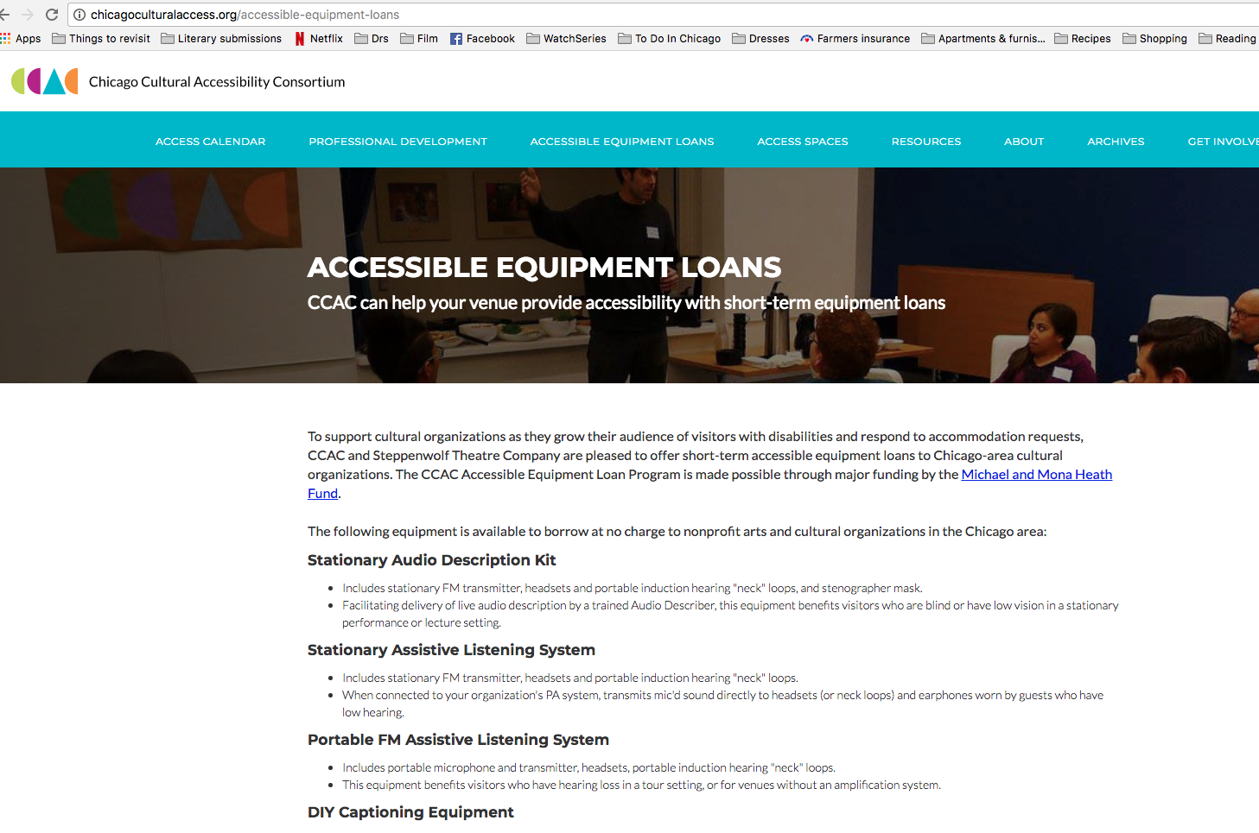
Or you can borrow an ALD kit from CCAC’s Equipment Loan Program for a one! chicagoculturalaccess.org/ accessible-equipment-loans

Slide 38
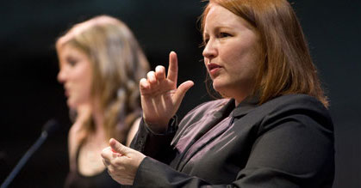
American Sign Language Interpretation (ASL)
Sign language comes in many languages. Don’t assume a language or interpretation preference. Not all deaf people know ASL. Set parameters for your guests to be able to request what they need. Think about the kind of sight lines someone needs to see the interpreter comfortably.

Slide 39
American Sign Language Interpretation (ASL)
How much does this cost? While this varies based on scripted vs live events, a live event interpreter tends to cost between $50 and $150 per hour depending on type of event, time/day. Learning a script for a theatrical performance costs more, typically $450 flat rate.

Slide 40
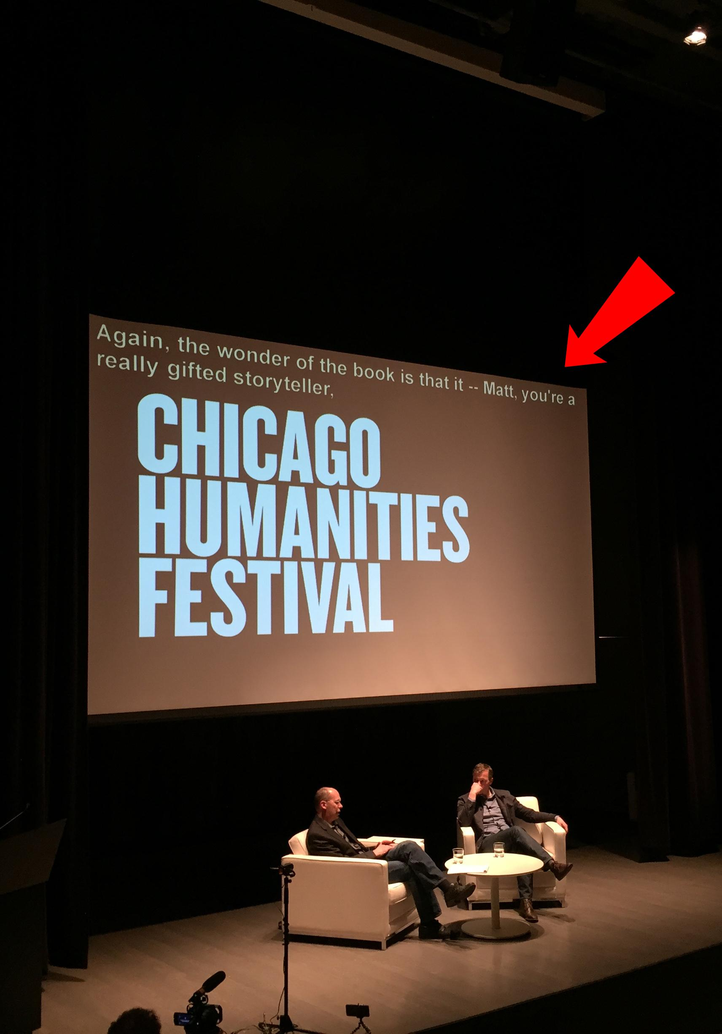
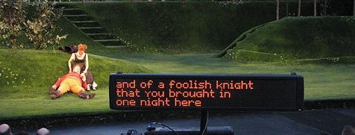
Open Captions
Open captioning displays dialogue and describes other relevant sounds on a screen above the stage or to the side of the stage. Captions are typed in real-time by a professional captioner in the venue. Open captions provide access for people at any stage of hearing loss.

Slide 41
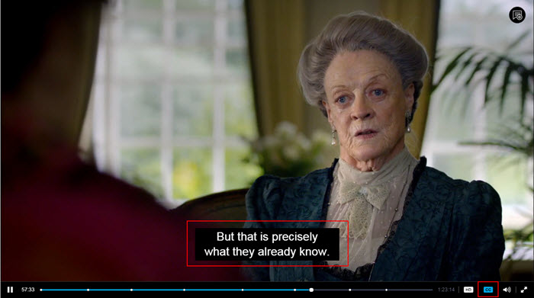
How is that different from closed captions?
Closed captions are visible to less people, usually on a device like a television or YouTube video. They can be turned off or on. Open captions are visible to everyone in a big room no matter their seating preference. They cannot be turned off.

Slide 42
CART
Computer Assisted Real-Time Translation A captioner (or CART-writer) uses a court reporting stenography machine, a computer, and software to display everything being said, word for word. Displays: computer, TV, projection, mobile

Slide 43
Open Captions
Again, don’t assume. Not every person who is deaf prefers captions. Some consider ASL their first language. Some feel that ASL conveys more emotion, humor, context than just words on a screen.

Slide 44
Open Captions
How much does this cost? Variations between scripted performances and live events. A live event captioner costs roughly $150 per hour.

Slide 45
If you want to borrow some TV screens or a projector & screen for captions, you can borrow those from CCAC’s Equipment Loan Programt too. chicagoculturalaccess.org/ accessible-equipment-loans

Slide 46
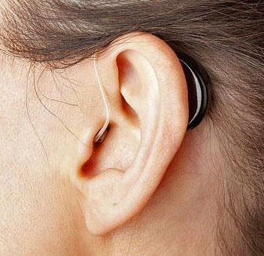
Take into account other preferences someone may have, like sight lines for lip reading or location for better hearing aid range.

Slide 47
ACCOMMODATIONS FOR
PHYSICAL ACCESS
Notes:
Anna

Slide 48
6.4% of Illinois population have a mobility disability
People may use wheelchairs, walkers, canes, and powered mobility devices (or no assistive device at all!)
Don’t:
Lean or hang on a person’s wheelchair
Push a person’s wheelchair unless asked
Do:
Try to sit or put yourself at their eye level
Ask people if they need assistance

Slide 49
Some Basic Accommodations:
Accessible entrance and route through experience
Proper reach ranges & wheelchair clearance for exhibit elements
Seating with and without armrests
Wheelchairs available for visitors
Accessible restrooms
Family/gender-neutral restrooms

Slide 50
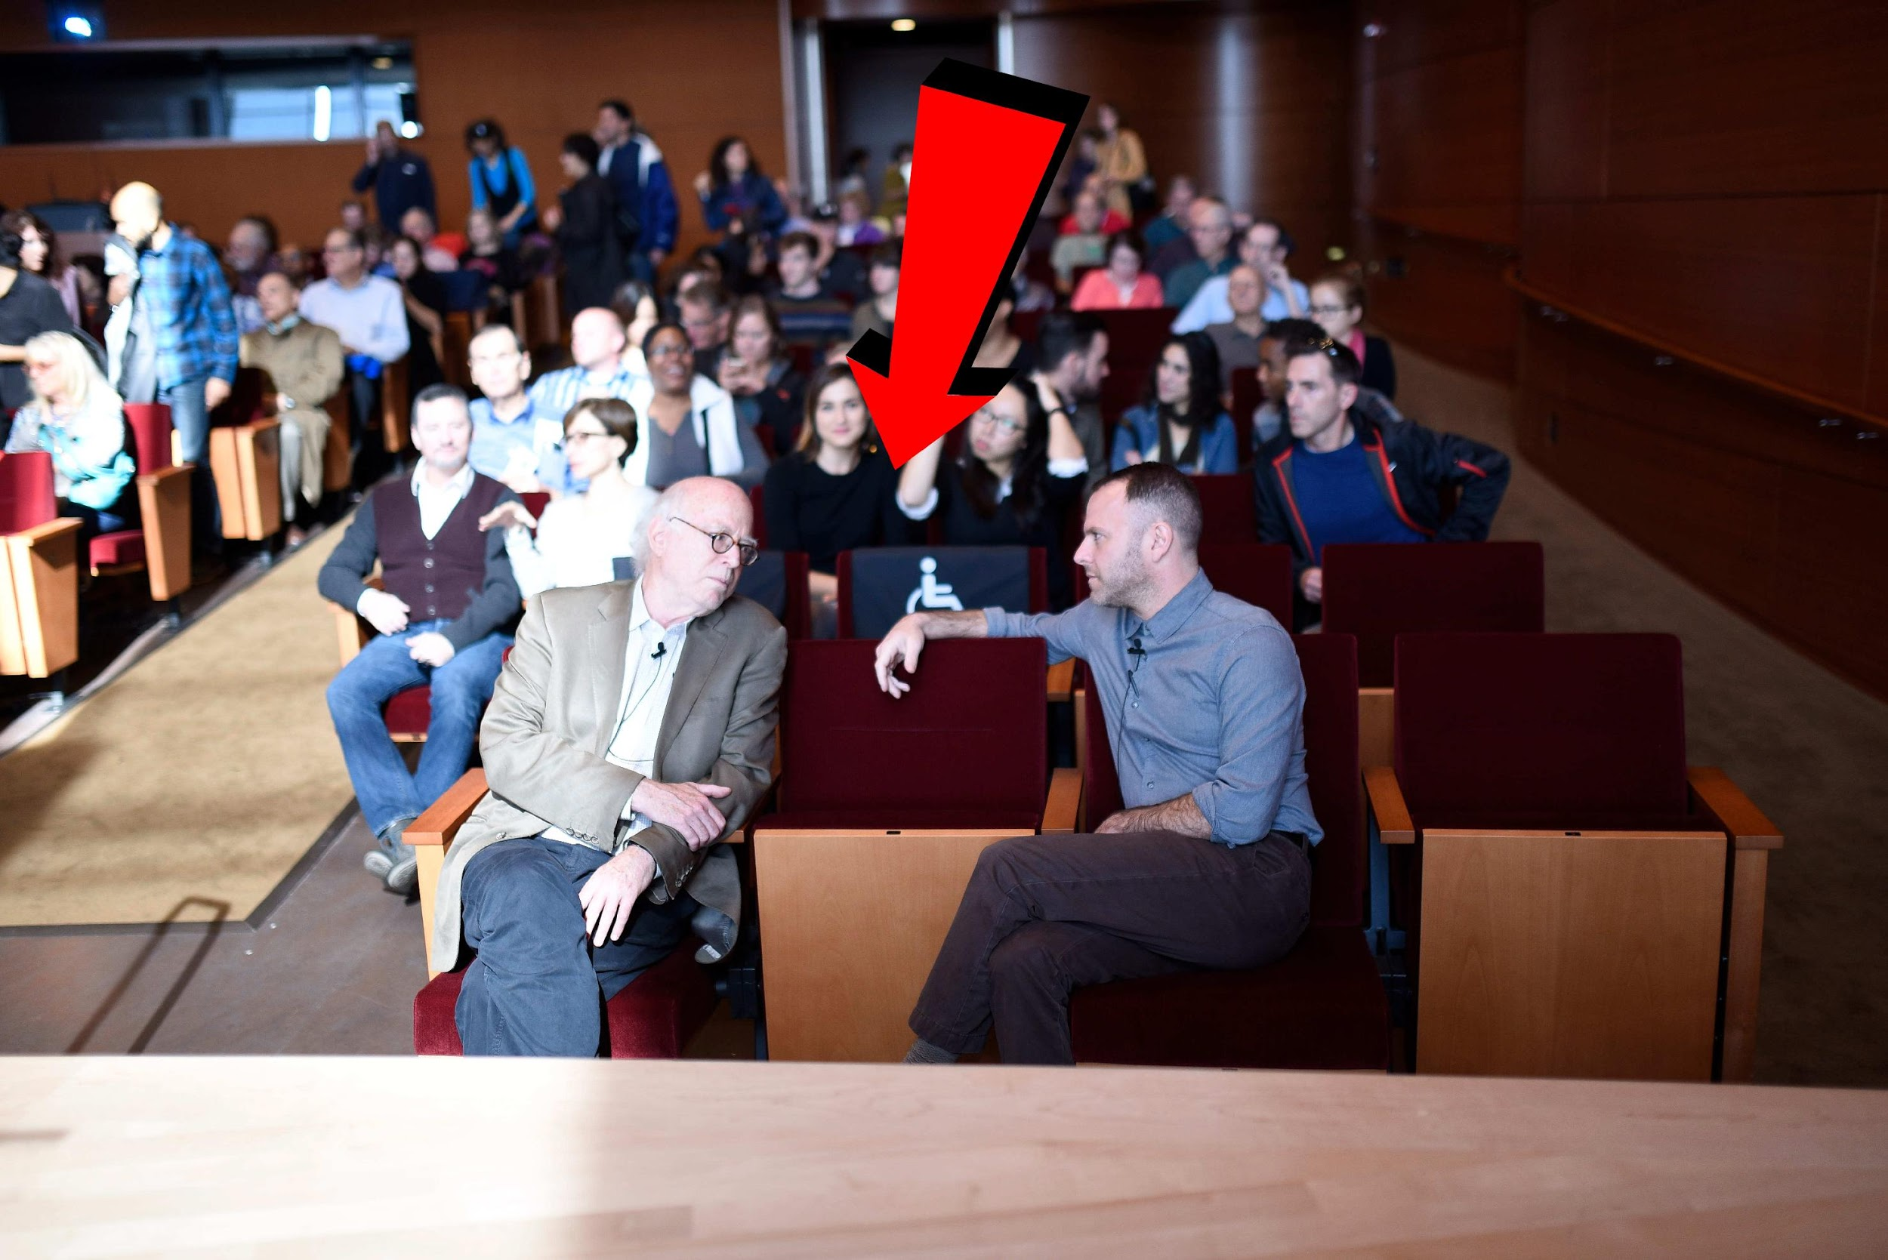

Slide 51
Seat prices should be fair and equal Main floor is more expensive than balcony seats? Only accessible seats are on main floor? Make sure your accessible seats have main floor AND balcony prices.

Slide 52
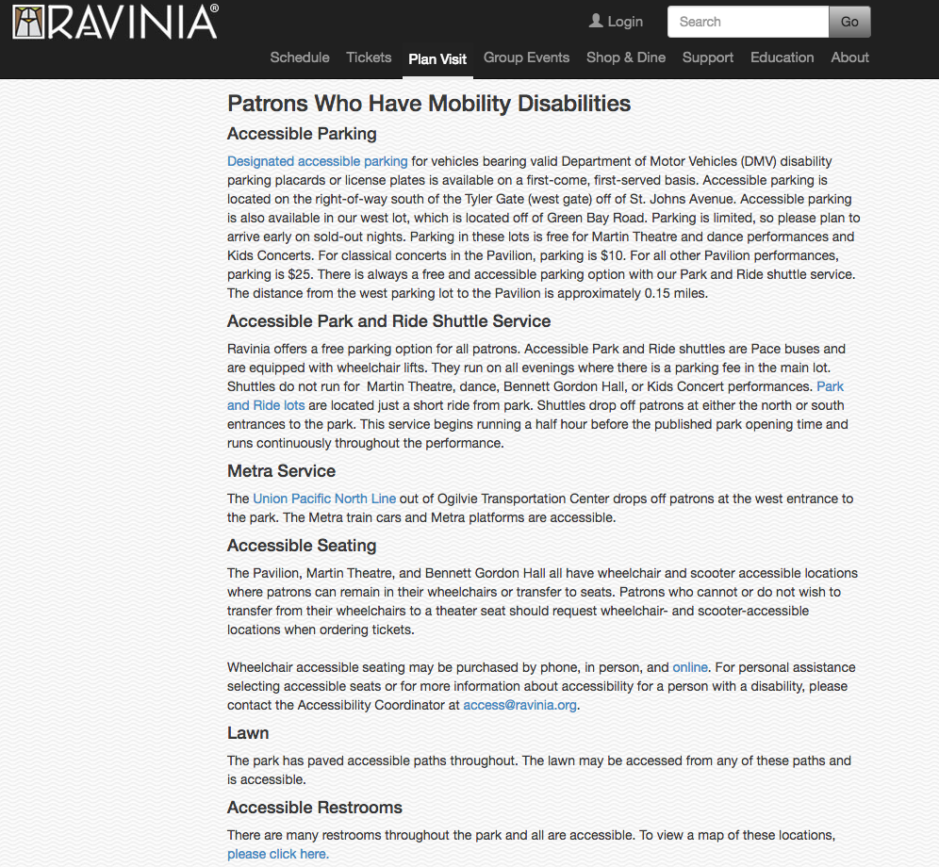

Slide 53
ACCOMMODATIONS FOR
VISUAL ACCESS
Notes:
Brittany

Slide 54
Service Animals
Welcome trained service animals and make considerations for visitors who are bringing them.

Slide 55
Service Animals
Service animals can be a dog or miniature horse. They can be trained to: -lead someone who is blind -open doors using a strap -prevent falls by bracing handler -and more!

Slide 56
Service Animals
Not sure? Ask what the animal is trained to do, not for proof/papers.

Slide 57
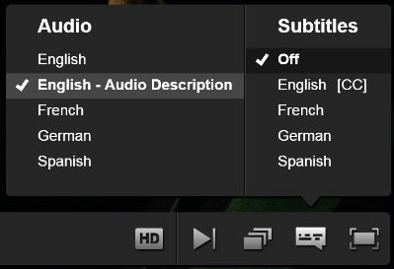
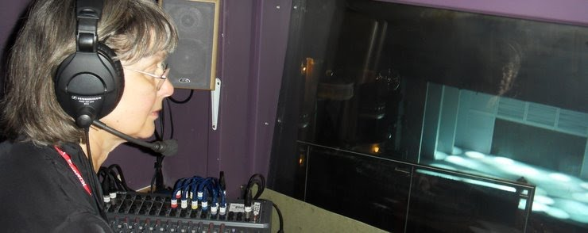
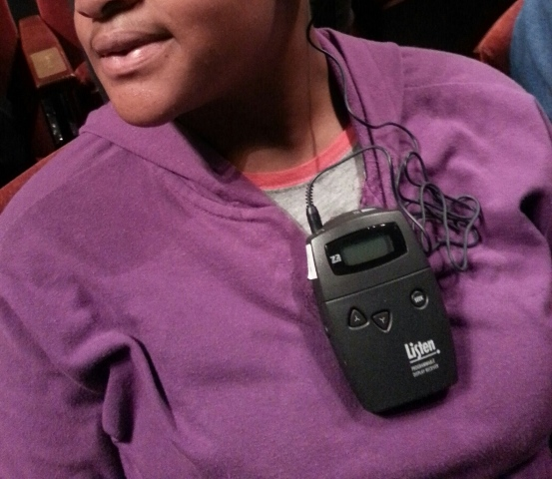
Audio Description
For people who are blind or low vision, audio description provides additional narration that describes important visual components and unspoken action of a piece of visual media or live performance.

Slide 58
Audio description equipment can be borrowed from CCAC’s Equipment Loan Program as well. chicagoculturalaccess.org/ accessible-equipment-loans

Slide 59
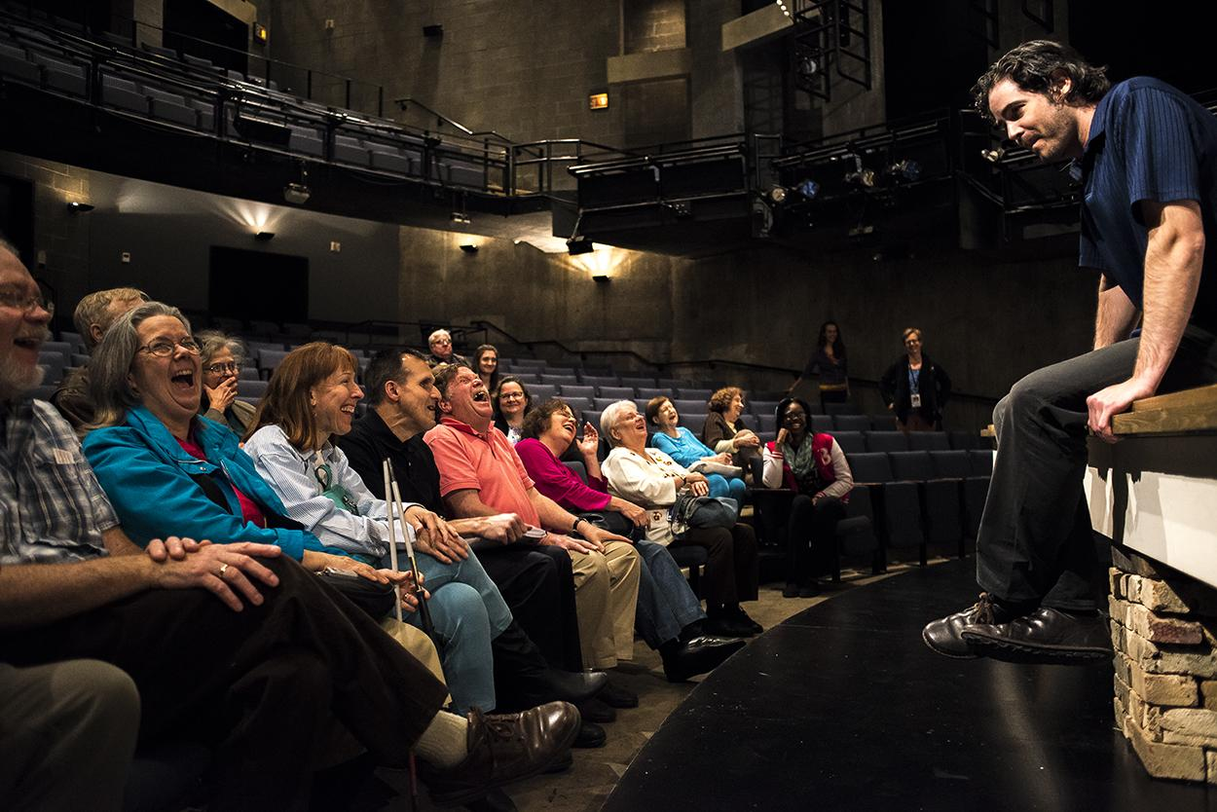
Touch Tours
Provide access to the stage and set before a performance as a way of firming up the descriptive information that sighted guests see. Typically lead by a staff member who describes the visual artistic choices, guests will explore the space, and may like to handle selected props, costumes, and furniture.

Slide 60
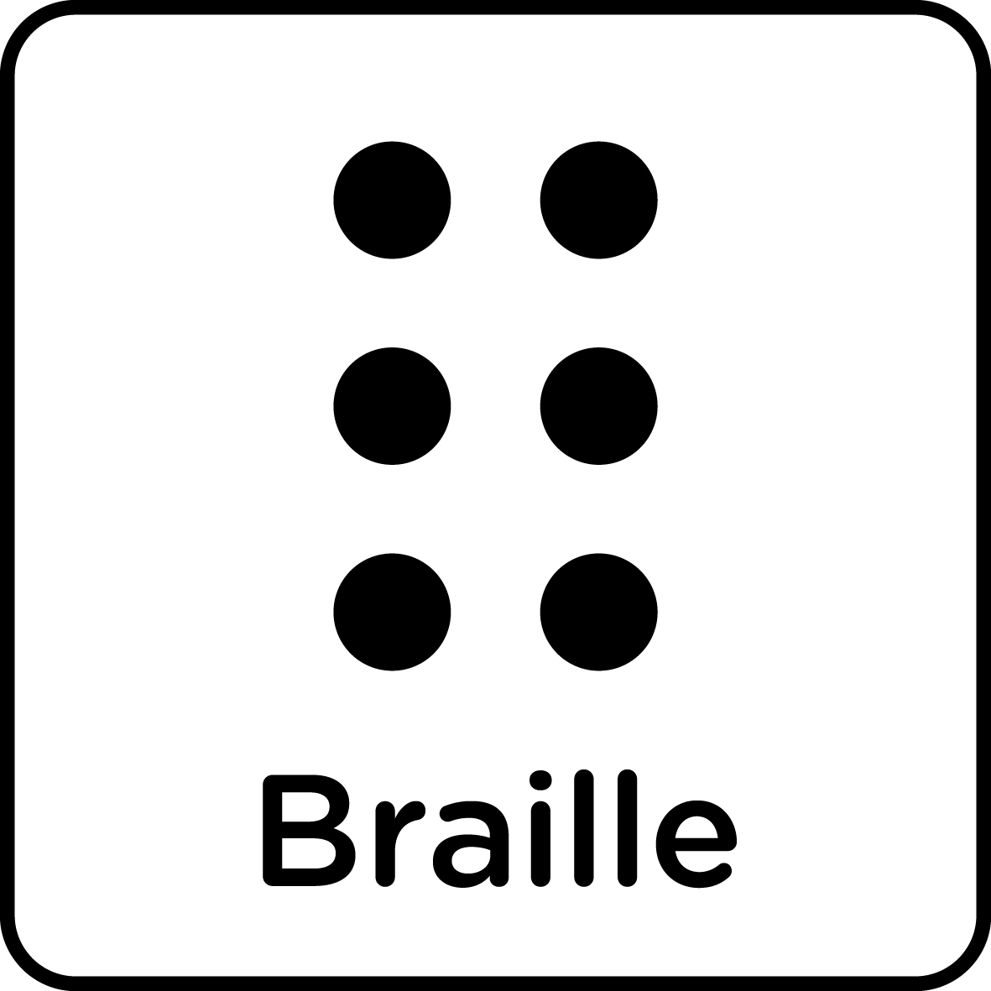
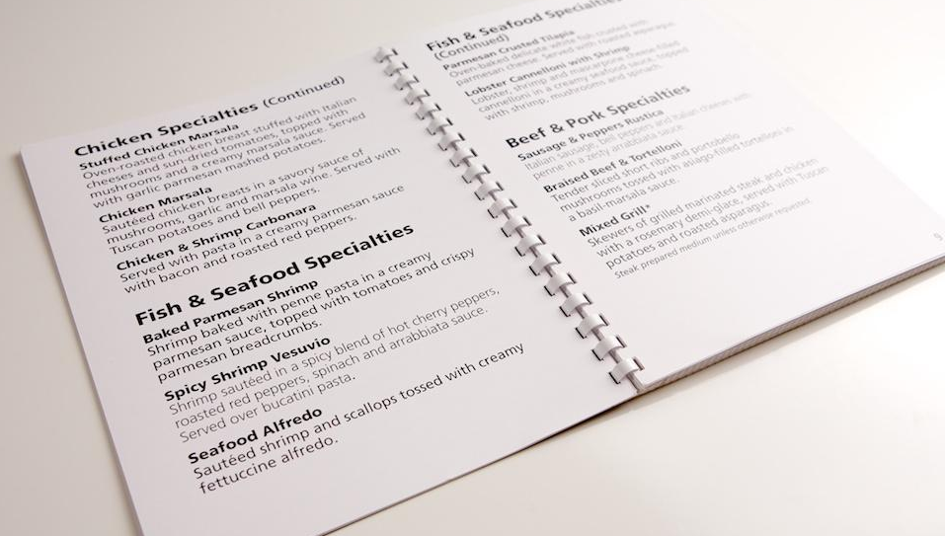
Braille and Large Print
If you offer important info in print, you should consider offering those materials in braille and large print too for your blind or low vision guests. You can use local and online vendors to have materials made in braille for a few dollars a sheet. Do your research on quality. Large print can be achieved cheaply by photocopying your existing brochure at 130%

Slide 61
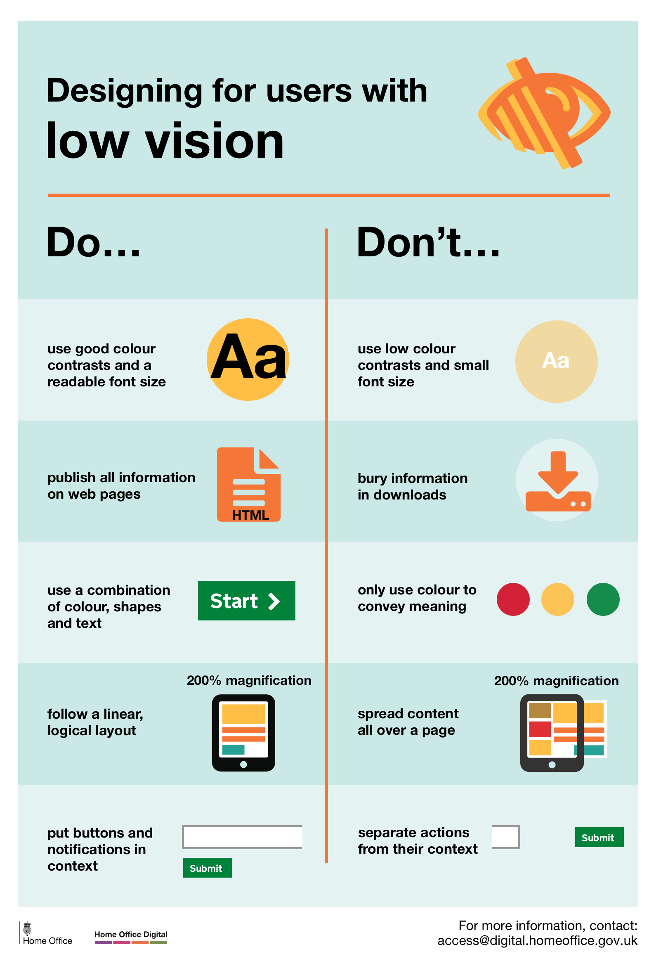
Design for visual access
Do -Use good color contrasts
-Large, readable fonts
-Linear layout with clear headers Don’t -use only color to convey meaning (color blindness) -spread a layout all over page -separate actions from their context (like random buttons)

Slide 62
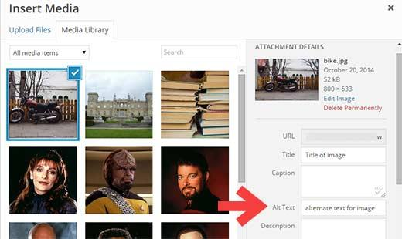
Design for visual access
Do -Use alt text when uploading images to your website or eblast so a blind person using a screen reader can have the image described to them Don’t -Convey textual information within an image only, because screen readers won’t pick it up

Slide 63
ACCOMMODATIONS FOR
PEOPLE WITH COGNITIVE DISABILITIES
Notes:
Anna

Slide 64
Cognitive Disabilities and Communication:
4% of Illinois population
Autism spectrum, Alzheimer’s, sensory-processing disorders
Use straightforward instructions. Avoid idioms.
Speak directly to the person and be age appropriate.
Listen attentively. Be patient and wait for the person to finish.
Don’t pretend you understand if you don’t; ask for clarification or repetition.

Slide 65
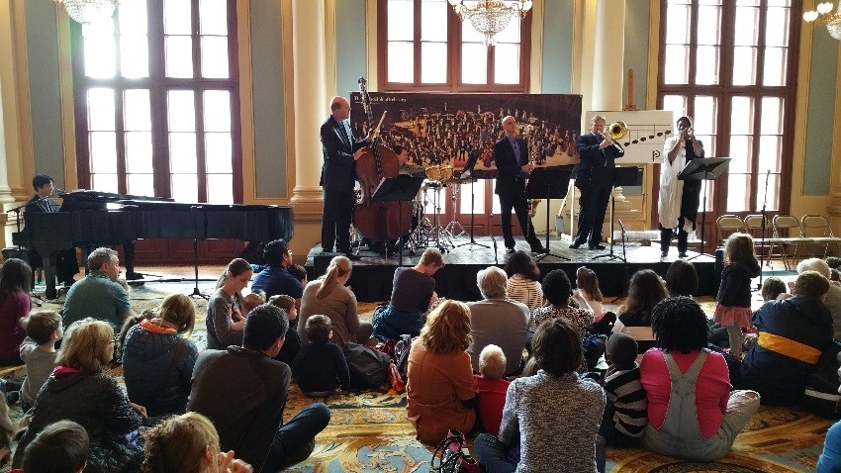
Sensory-Friendly/Relaxed Programs
Minimize crowds
Provide a quiet area
Relaxed environment where it’s ok to make noise
Raised lights so guests can go in and out easily
Scent-free environment

Slide 66
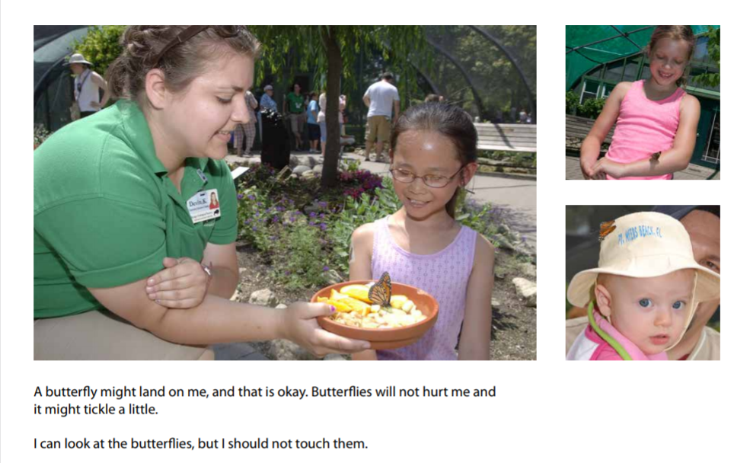
Social Stories and Visual Schedules

Slide 67
Things to Keep in Mind for ALL Accommodations
No one-size fits all solutions.
Create a way for people to request accommodations.
If someone requests something you can’t do, have a conversation, don’t say “no.”
Some accommodations are scheduled others by request
ADA prohibits passing cost on to visitors.

Slide 68
How do we let people know we are accessible?

Slide 69
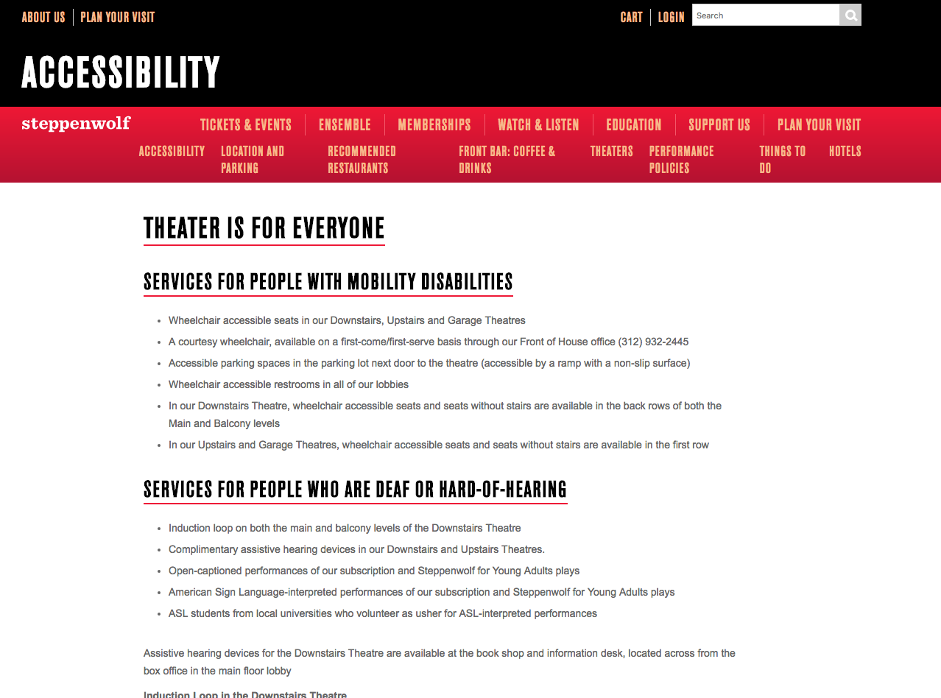
Notes:
Brittany - Thorough information about accessibility on website

Slide 70
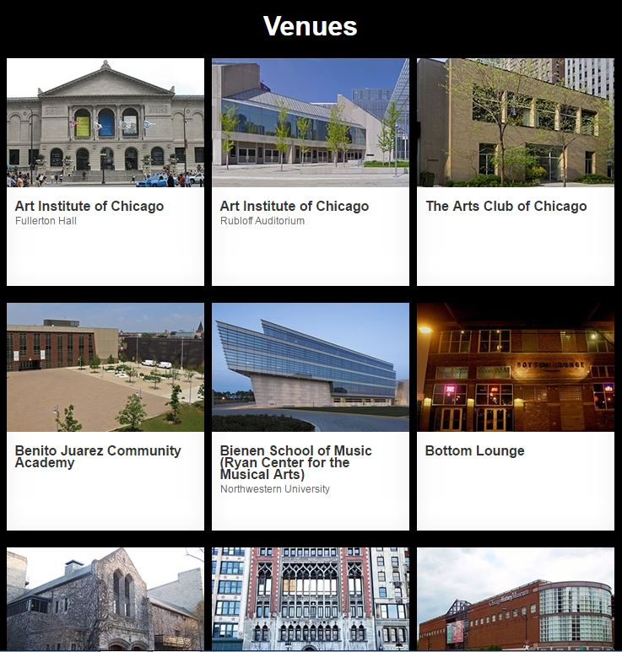
Notes:
Brittany - image is linked to CHF Venues webpage

Slide 71
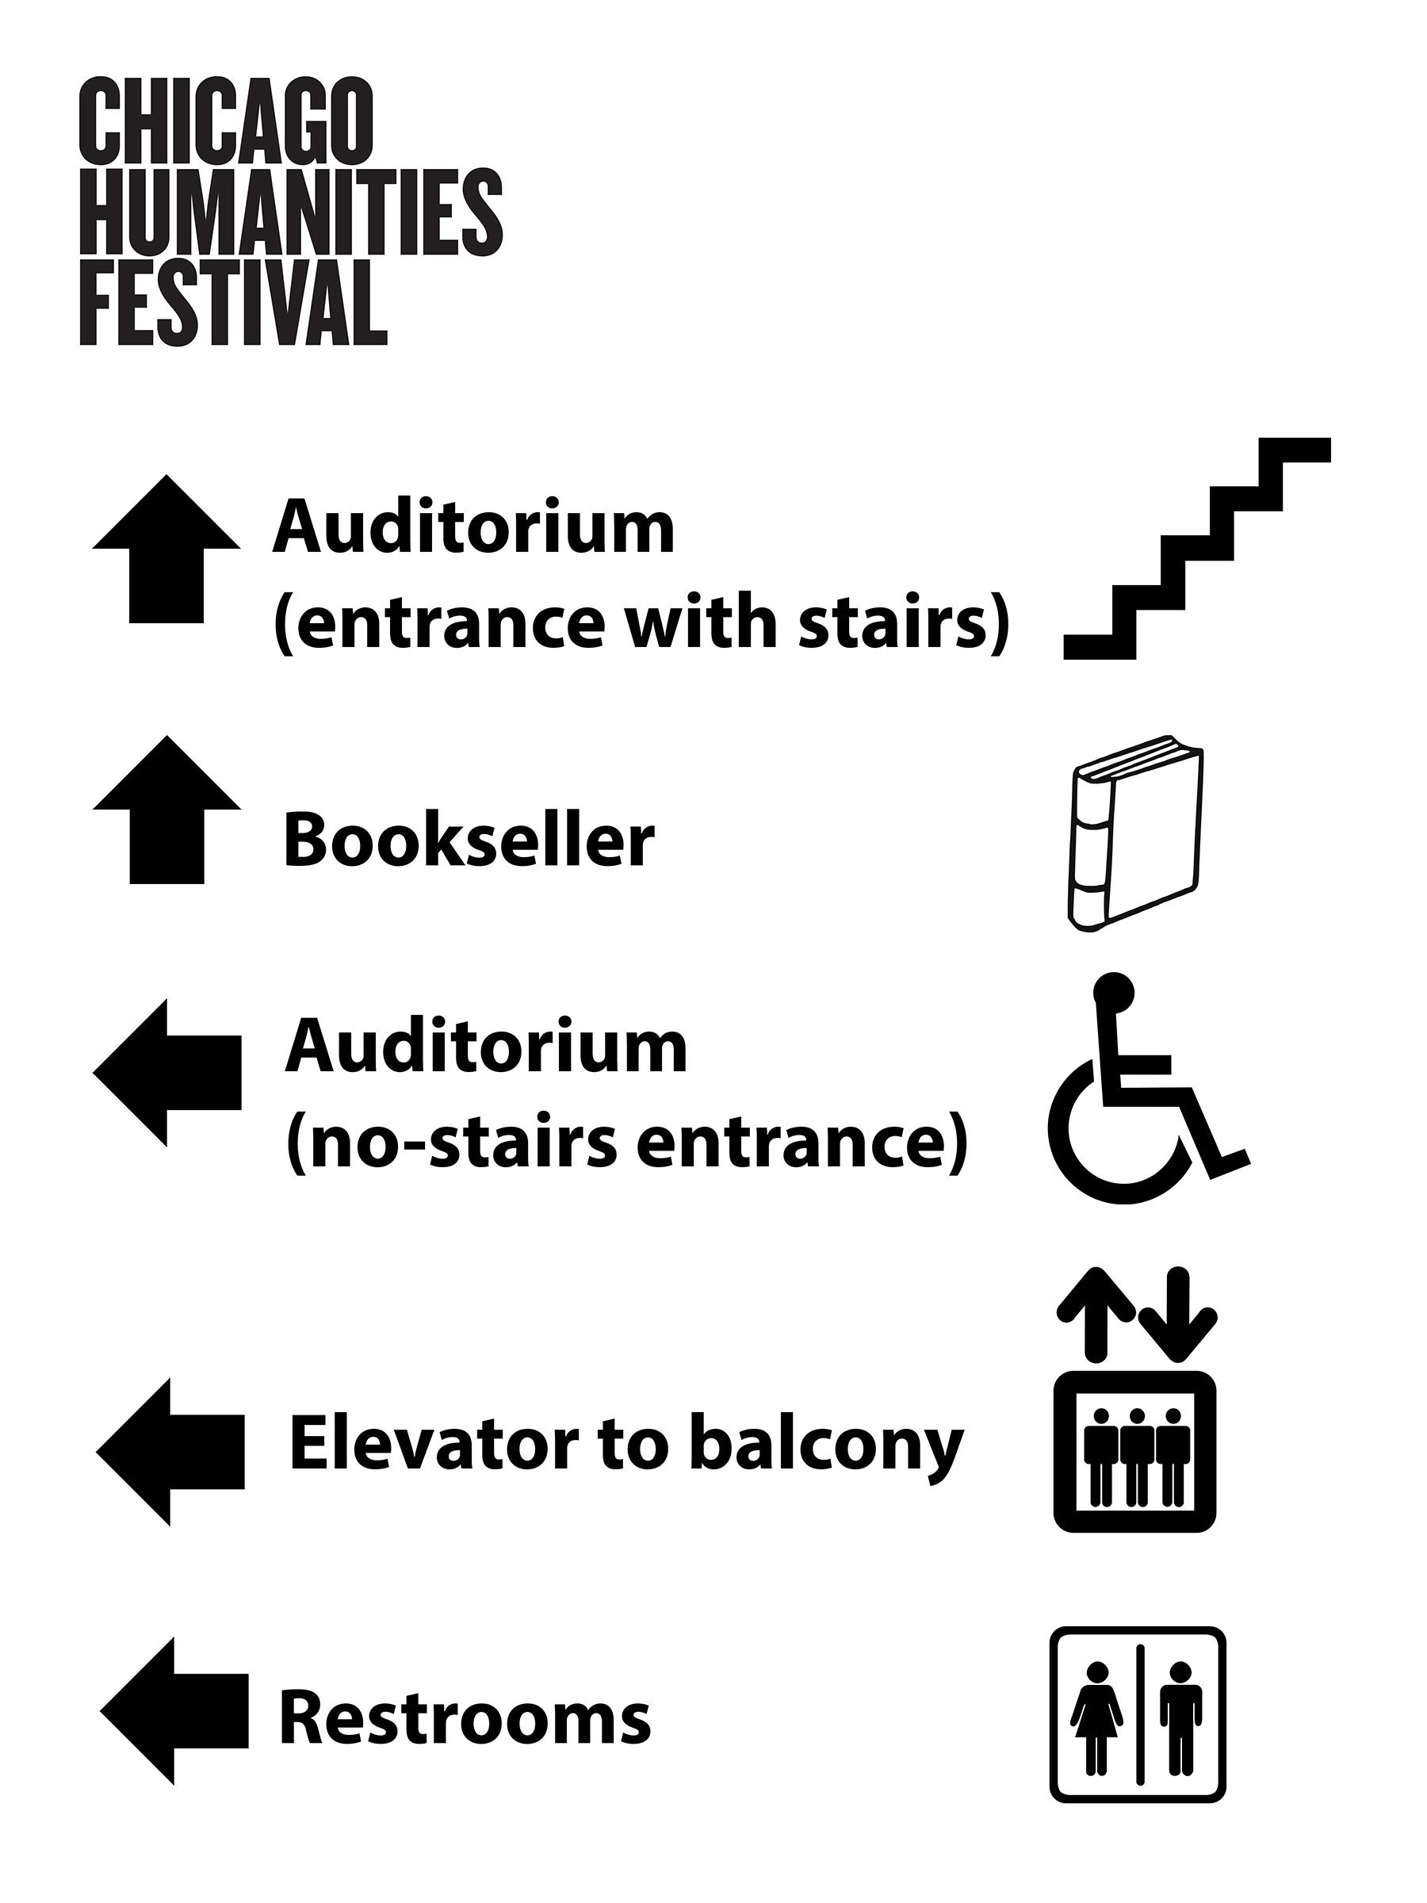
Notes:
Brittany - I bring in tons of signage!

Slide 72
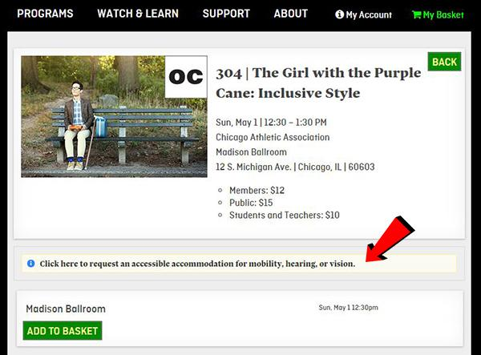
Notes:
Brittany

Slide 73
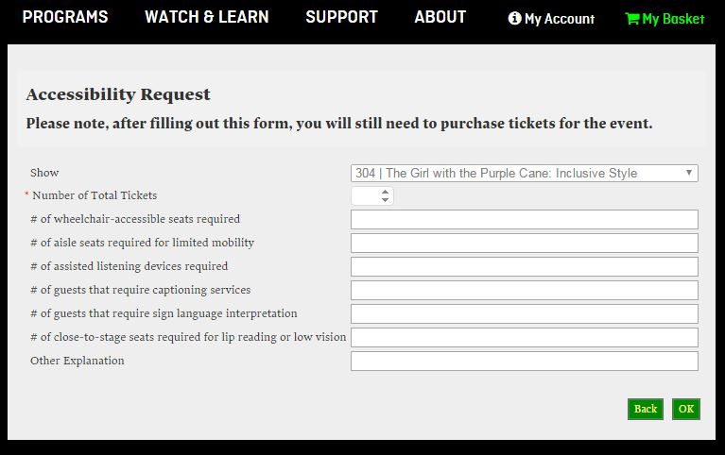
Notes:
Brittany

Slide 74
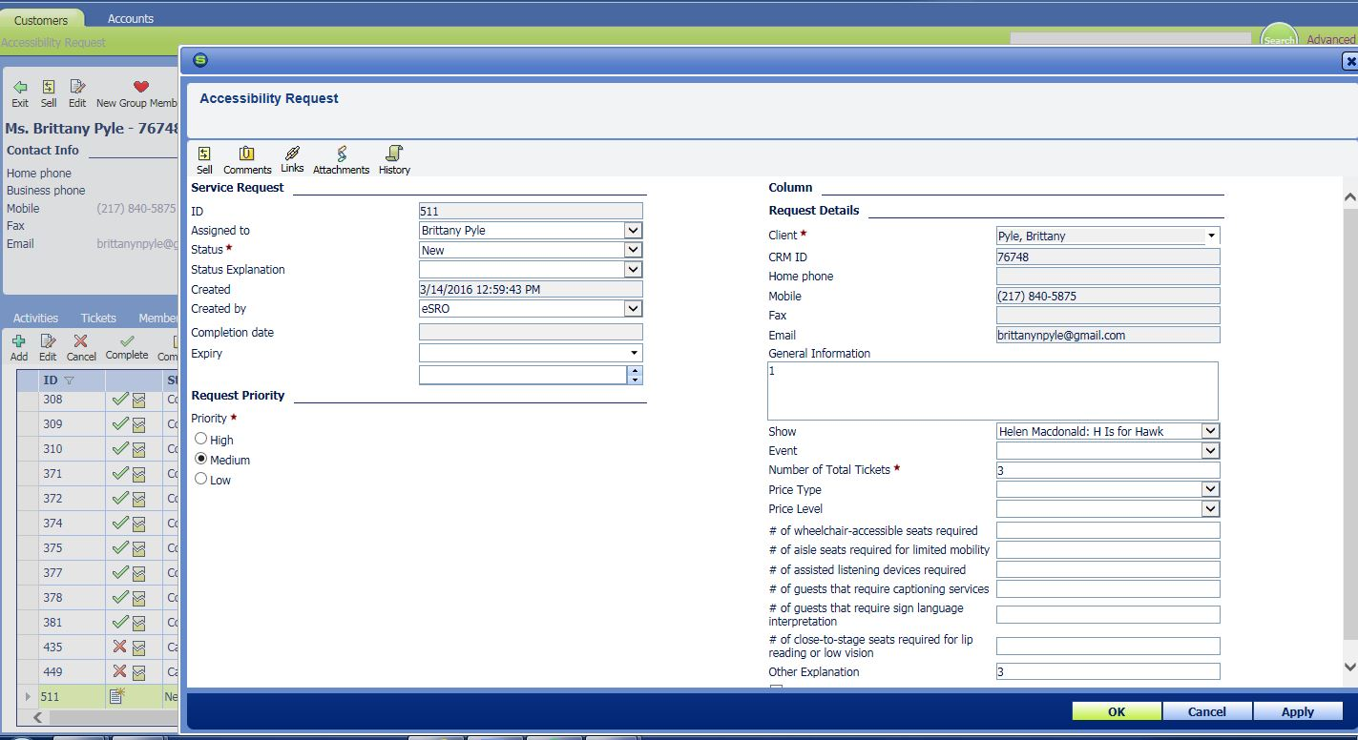
Notes:
Brittany

Slide 75
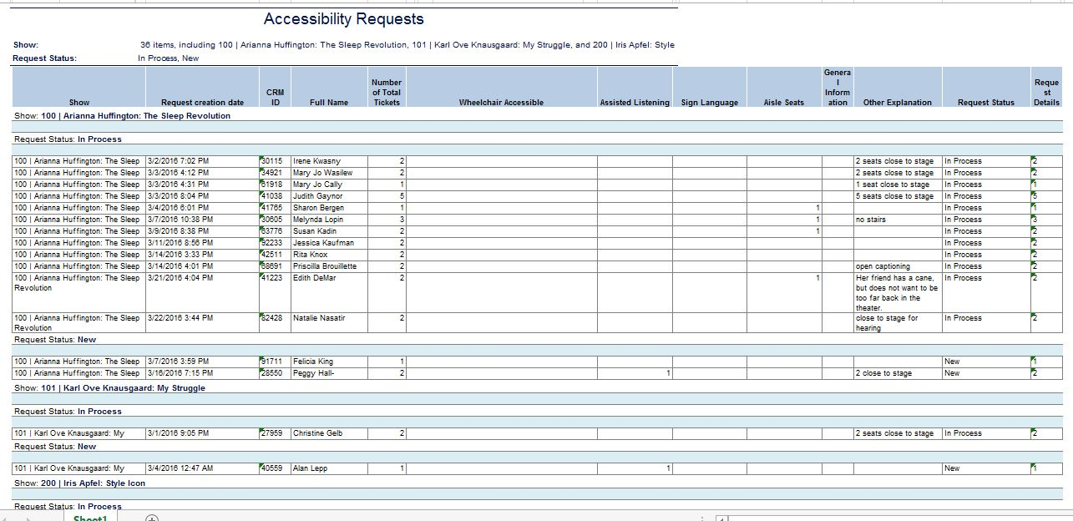
Notes:
Brittany

Slide 76
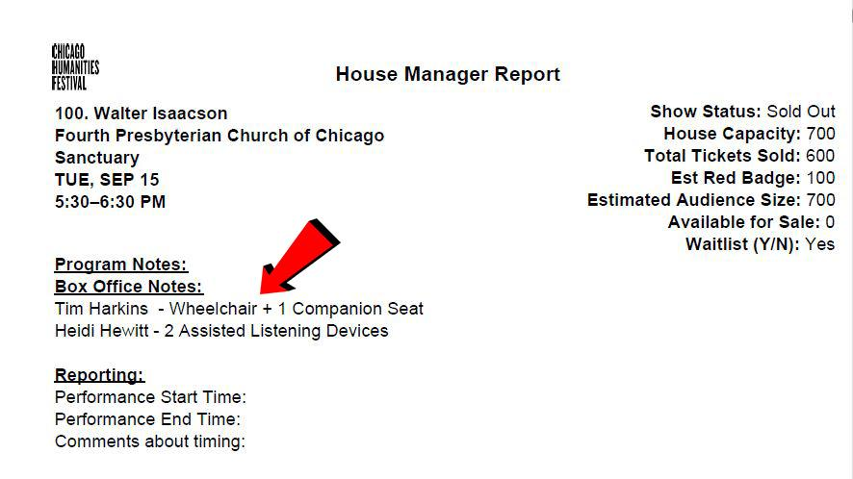

Slide 77
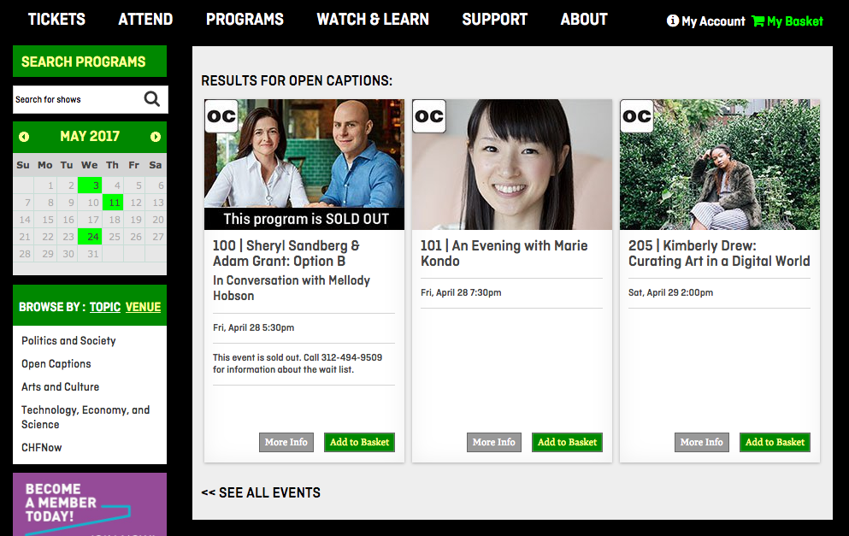
Notes:
Brittany - Once we know an event will have captions or sign language, we’ll add the symbol to the event page --- and add a filter for it in the left column

Slide 78
Start budgeting and planning for access Accessibility is achieved holistically by ALL these helpers: -guest services
-education
-development
-marketing
-programming / artistic direction
-finance and operations
-human resources

Slide 79
Do some outreach and partner up -Sign up for CCAC’s email list serv
-Promote your event’s on CCAC’s access calendar -Connect to facebook and meetup groups with disabilites -Connect to local agencies that serve these communities -Connect with colleges and universities with programs on disability and human development, universal design, sign language (UIC, Columbia College) -Partner with organizations that train staff, such as JJ’s List -Partner with artists/performers with disabilities

Slide 80
Resources chicagoculturalaccess.org/resources
ASL interpreters CAIRS Chicago Hearing Society
Captioning Services Efficiency Reporting (real time CART) CaptionAccess (real time CART) CaptionPoint (scripted performance)
C2 (scripted performance) CART-writers Catherine Rajcan - crajcan@efficiencyreporting.com Jo Gayle - jigcsr@gmail.com
Equipment CCAC Equipment Loan Program (for borrowing) TC Furlong (for buying) Experienced Audio Describers Aaron Aptaker - aaronaptaker@gmail.com
Evan Hatfield - evanhat@gmail.com
Jason Harrington - jharrington@chicagoshakes.com
Shayne Kennedy - shaynekennedy@comcast.net
Jack Miggins - jackmiggins@gmail.com
Martin Wilde - martin@wildemouth.com
Will Quam - willquam@gmail.com

Slide 81
QUESTIONS?

